Slide 1
Relative Vectoring
Using Dual Object Detection

Slide 2
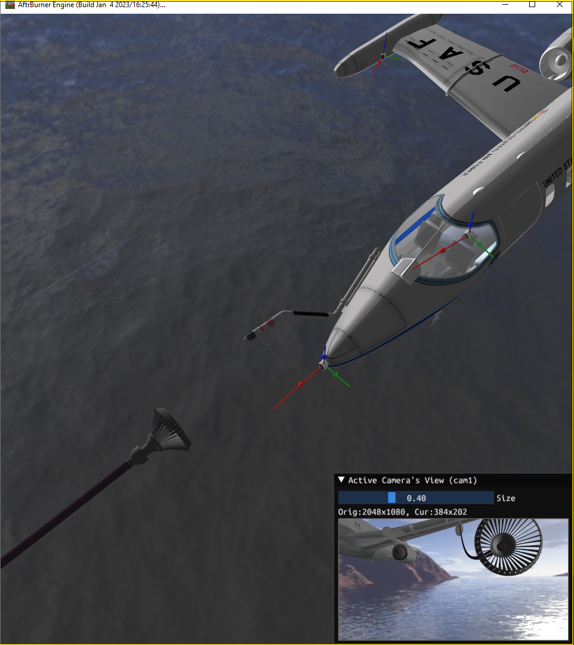
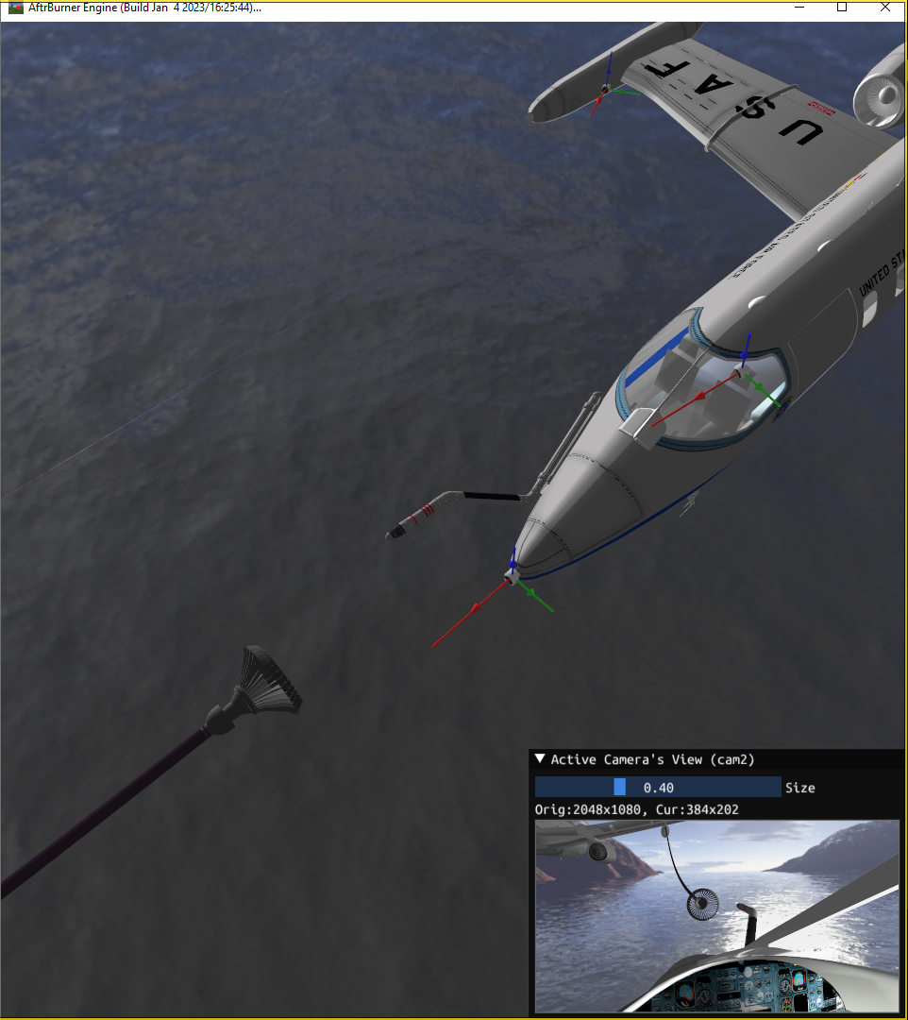
Current methods
Proposed method
camera-to-probe
probe offset
probe-to-drogue
probe-to-drogue
camera-to-drogue
camera-to-drogue

Slide 3
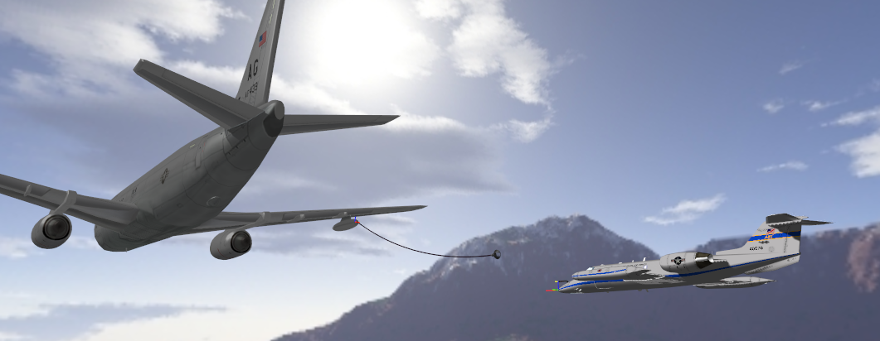
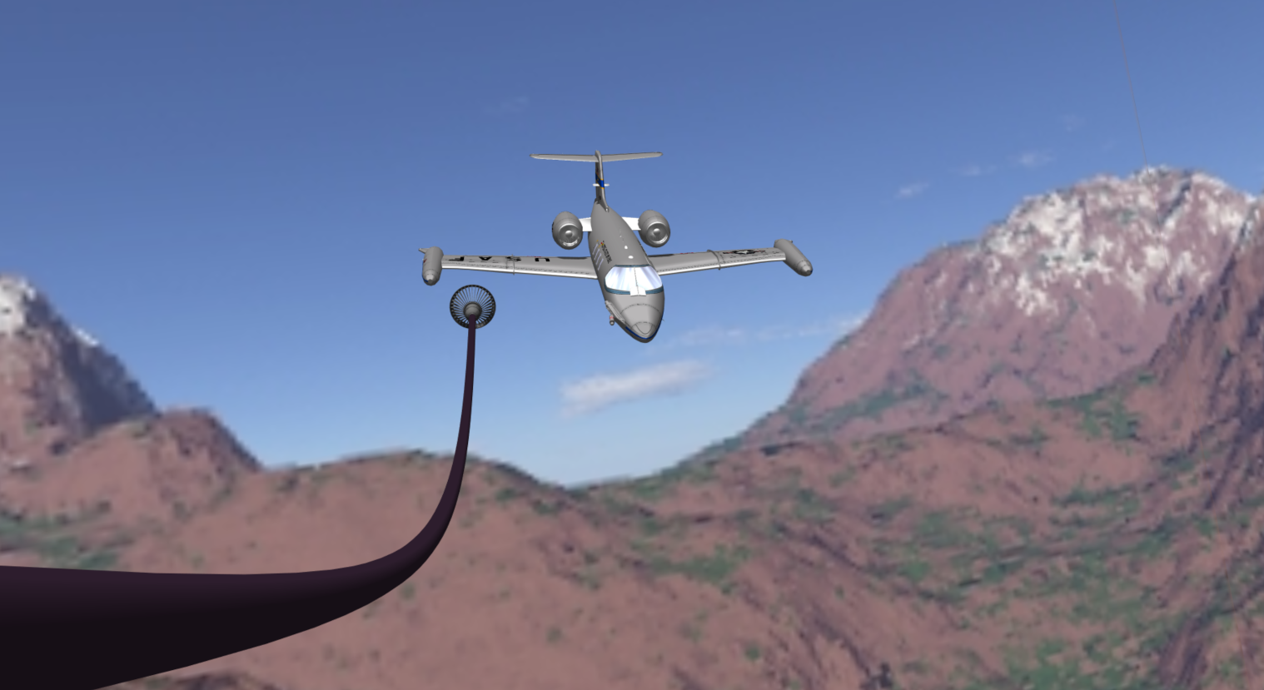
Rear facing
camera
1
Capture image
Image
2
Find 2D points
receiver
points
2D points
3
Match 2D to
3D points
drogue matches
(u₀, v₀) <-> (x₀, y₀, z₀)
(u₁, v₁) <-> (x₁, y₁, z₁)
(u₂, v₂) <-> (x₂, y₂, z₂)
…
(u_{m}, v_{m}) <-> (x_{m}, y_{m}, z_{m})
drogue
points
receiver matches
(u₀, v₀) <-> (x₀, y₀, z₀)
(u₁, v₁) <-> (x₁, y₁, z₁)
(u₂, v₂) <-> (x₂, y₂, z₂)
…
(u_{n}, v_{n}) <-> (x_{n}, y_{n}, z_{n})
Matches
4
Transform matches
into poses (SolvePnP)
Poses
5
Transform poses
into PtD vector
drogue
pose
receiver
pose
PtD vector
Autonomous agents pilot the aircraft
PtD vector

Slide 4


Dual Object Detection
Camera Instrinsics
(from calibration)
Object 1 & 2 3D points
(models known a priori)
Image of
2 objects
Object 1
2D points
[R|t]_{Obj1}
[R|t]_{Obj2}
Camera
YOLO
Solve
PnP
Vector
Trans.
relative nav.
vector
Object 2
2D points

Slide 5
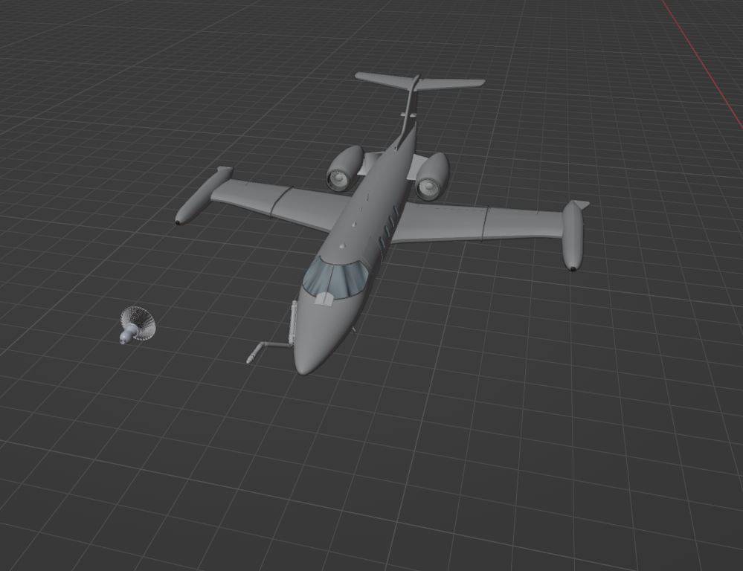
2D pts
2D pts
ID
ID
3D pts
3D pts
(u₁, v₁)
(u₂, v₂)
(u₃, v₃)
(u₄, v₄)
(u₅, v₅)
(u₁, v₁)
(u₂, v₂)
(u₃, v₃)
(u₄, v₄)
(u₅, v₅)
p1
p2
p3
p4
p5
p1
p2
p3
p4
p5
(x₁, y₁, z₁)
(x₂, y₂, z₂)
(x₃, y₃, z₃)
(x₄, y₄, z₄)
(x₅, y₅, z₅)
(x₁, y₁, z₁)
(x₂, y₂, z₂)
(x₃, y₃, z₃)
(x₄, y₄, z₄)
(x₅, y₅, z₅)
p2
p1
(u₆, v₆)
(u₇, v₇)
(u₈, v₈)
(u₉, v₉)
(u₆, v₆)
(u₇, v₇)
(u₈, v₈)
(u₉, v₉)
d1
d2
d3
d4
d1
d2
d3
d4
(x₆, y₆, z₆)
(x₇, y₇, z₇)
(x₈, y₈, z₈)
(x₉, y₉, z₉)
(x₆, y₆, z₆)
(x₇, y₇, z₇)
(x₈, y₈, z₈)
(x₉, y₉, z₉)
d1
p4
d2
d4
d3
p3
[R_{d}, t_{d}]
p5
model points
(u, v)
p2
p1
d1
d2
d4
d3
p5
p3
p4
YOLO
predictions
[R_{p}, t_{p}]
camera pose

Slide 6
ꓕ
PtD vector =
R_{p}(t_{d} - t_{p})
t_{d} - t_{p}
drogue pose
t_{d} - t_{p}
receiver pose
t_{d}
t_{p}
camera pose

Slide 7
Bounding box corrections
Corrected
bounding box
2Δy
Occluded
feature points
Sensed
feature points
True
3D center
Δy
Original
center
Δx
Original
bounding box
2Δx

Slide 8
Simulation Results

Slide 9
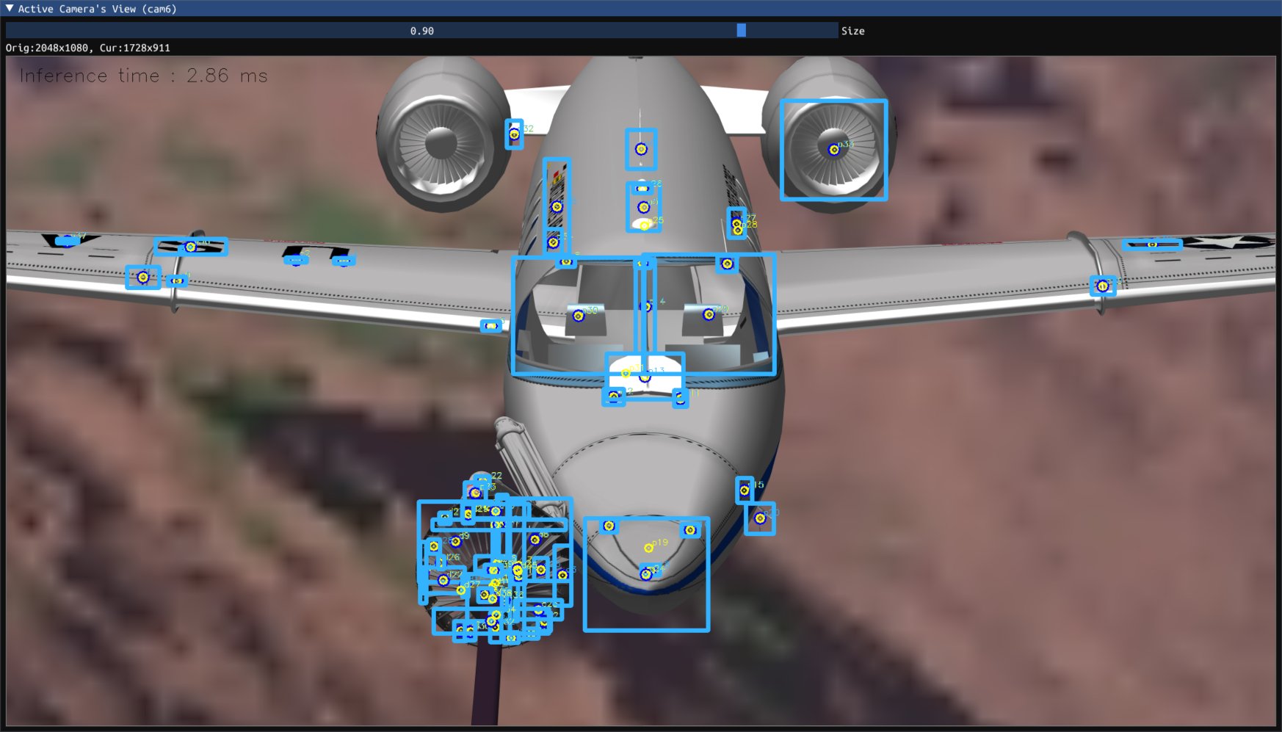
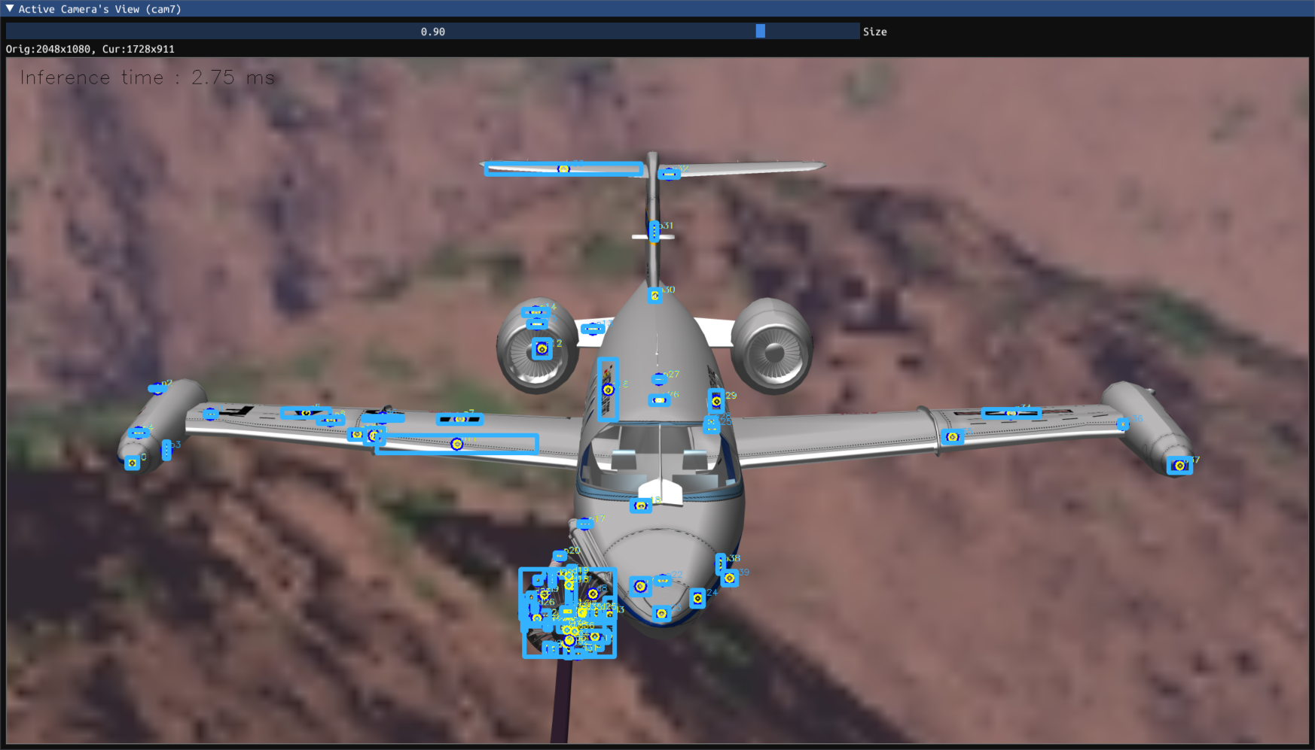
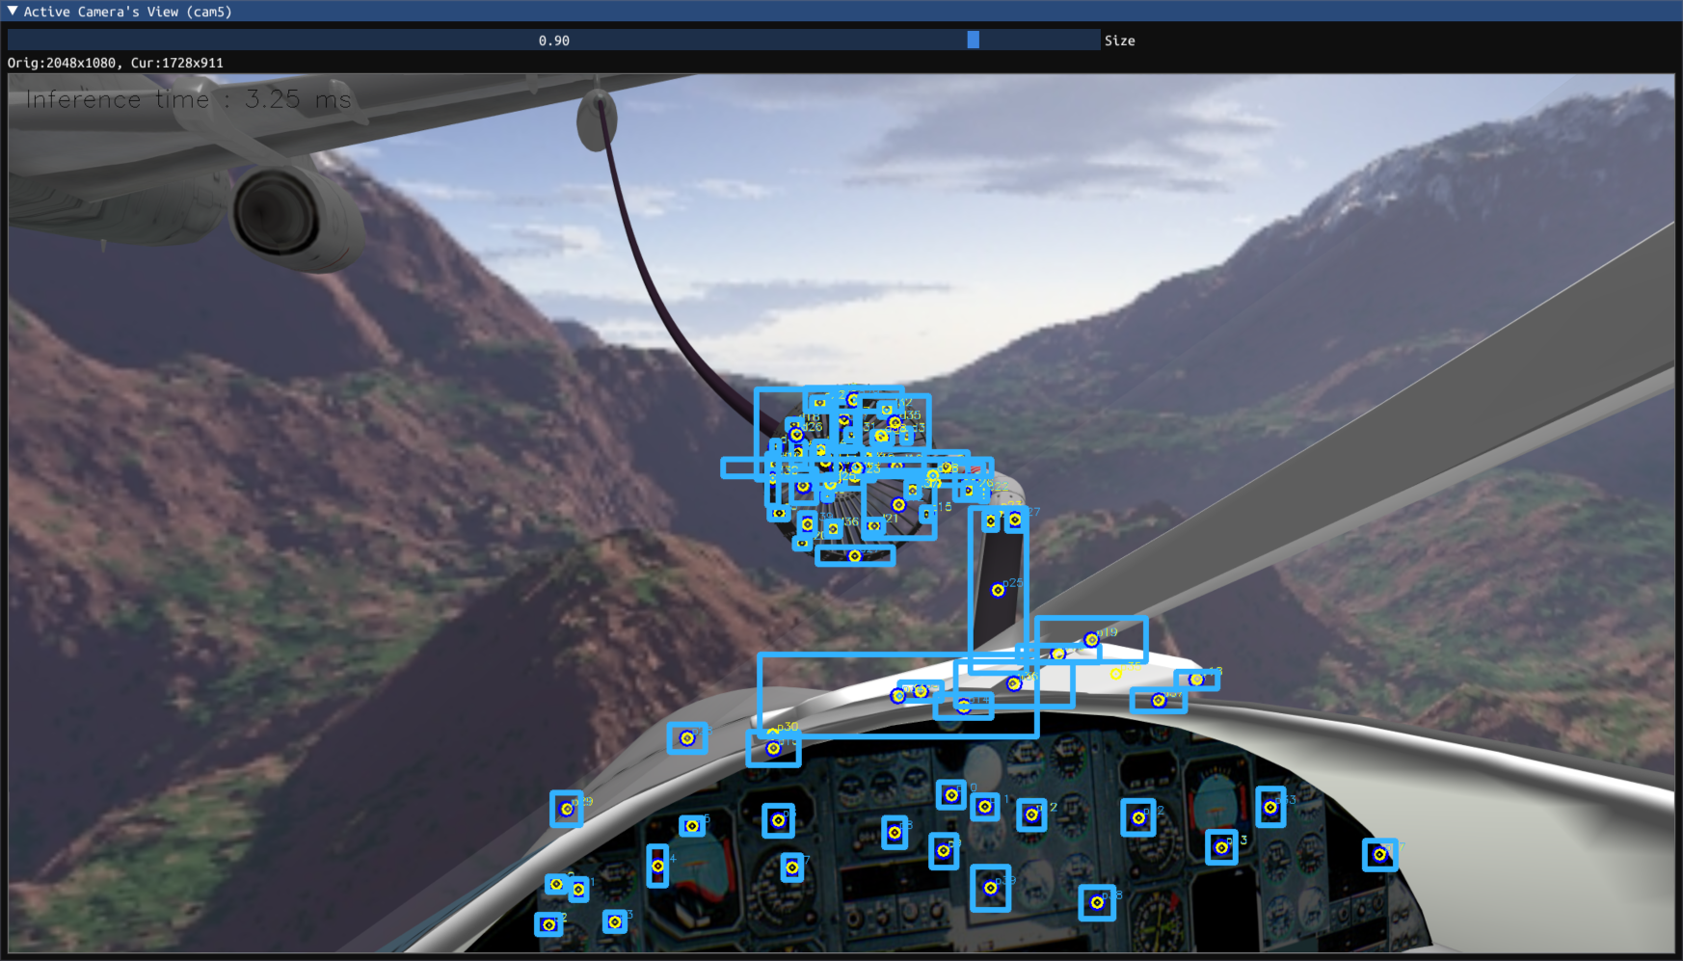
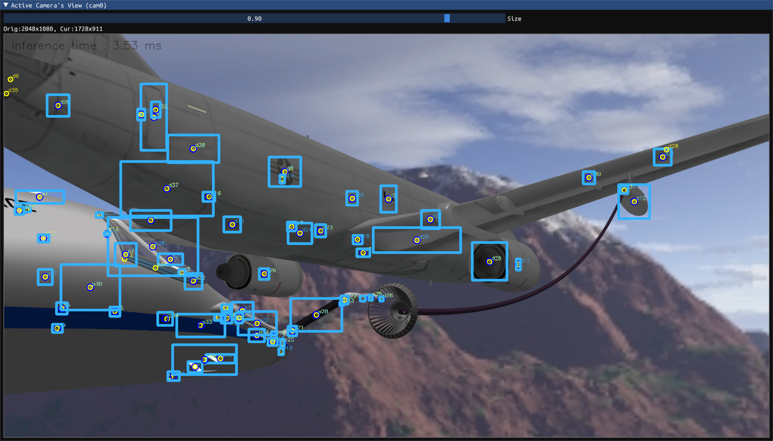

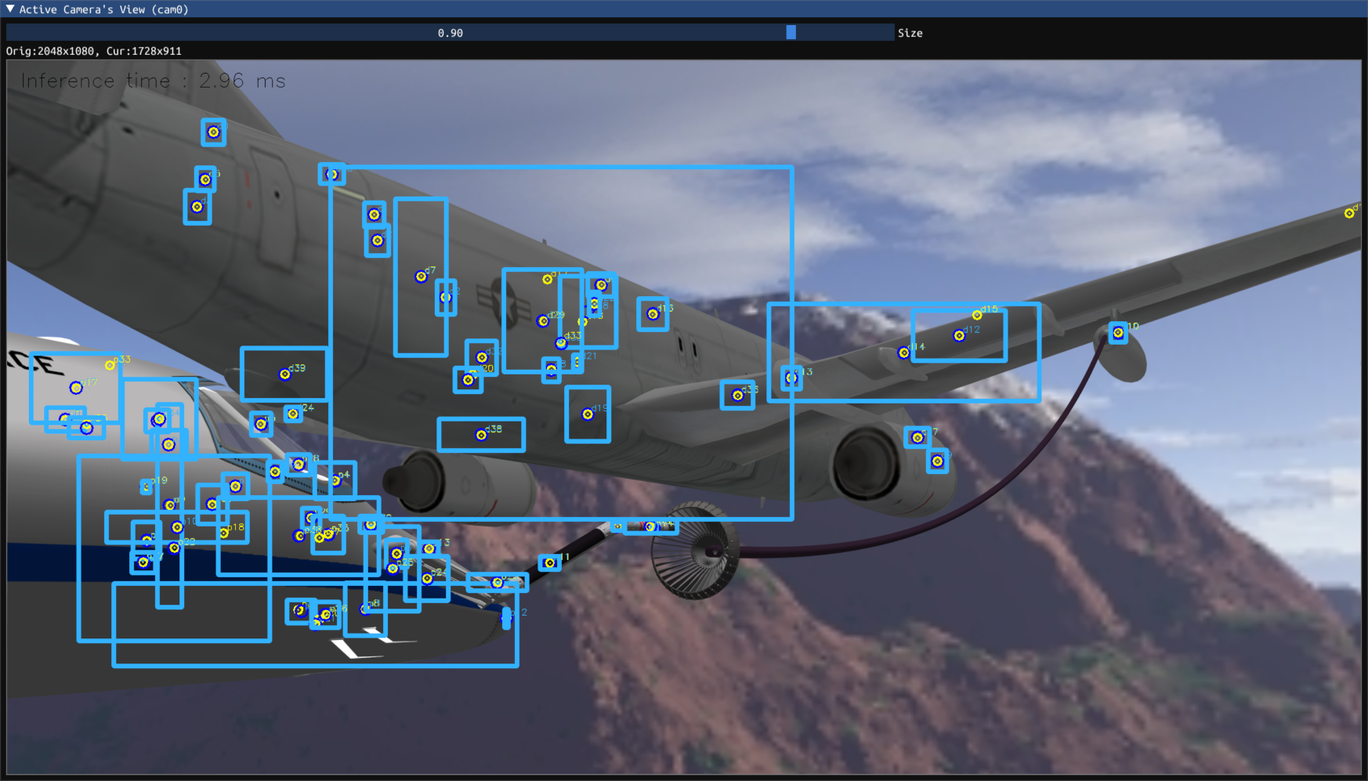
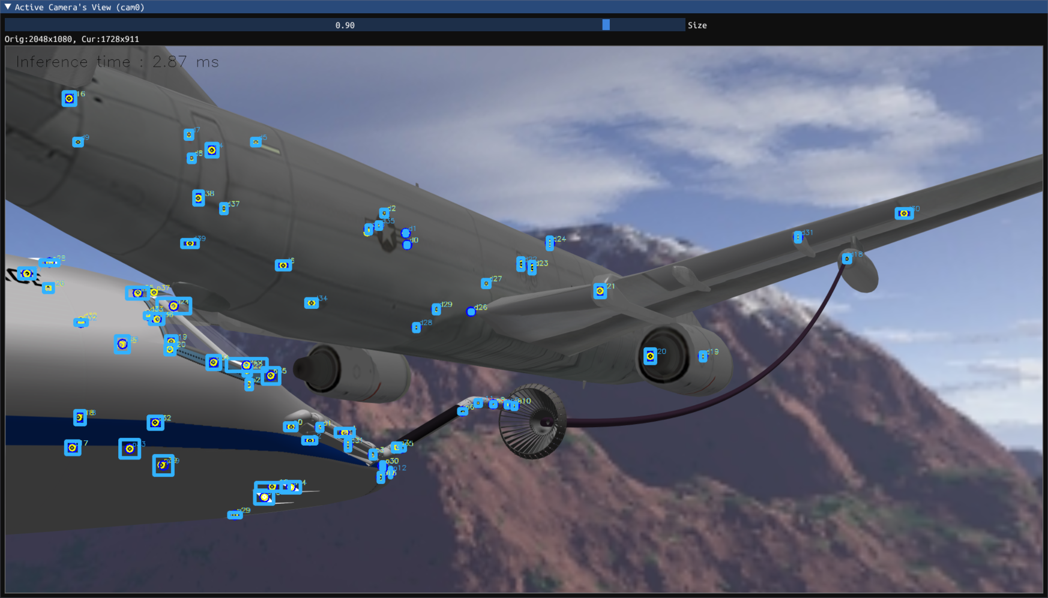
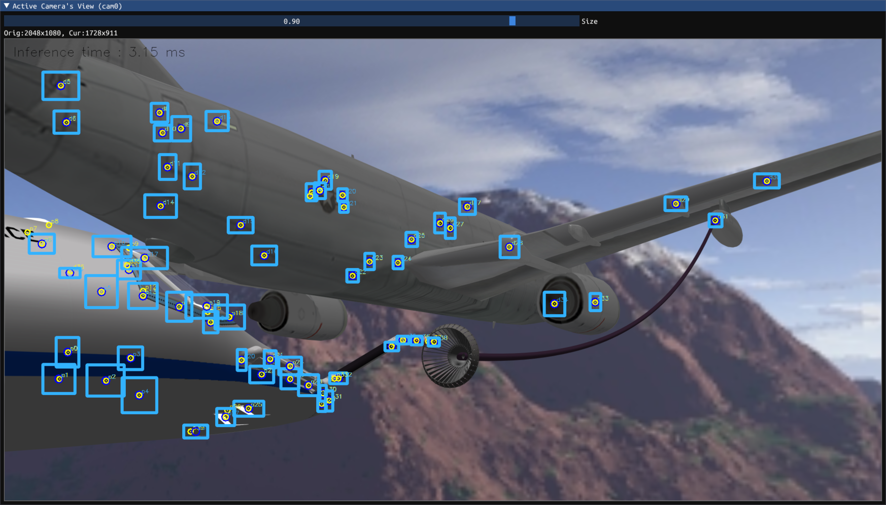
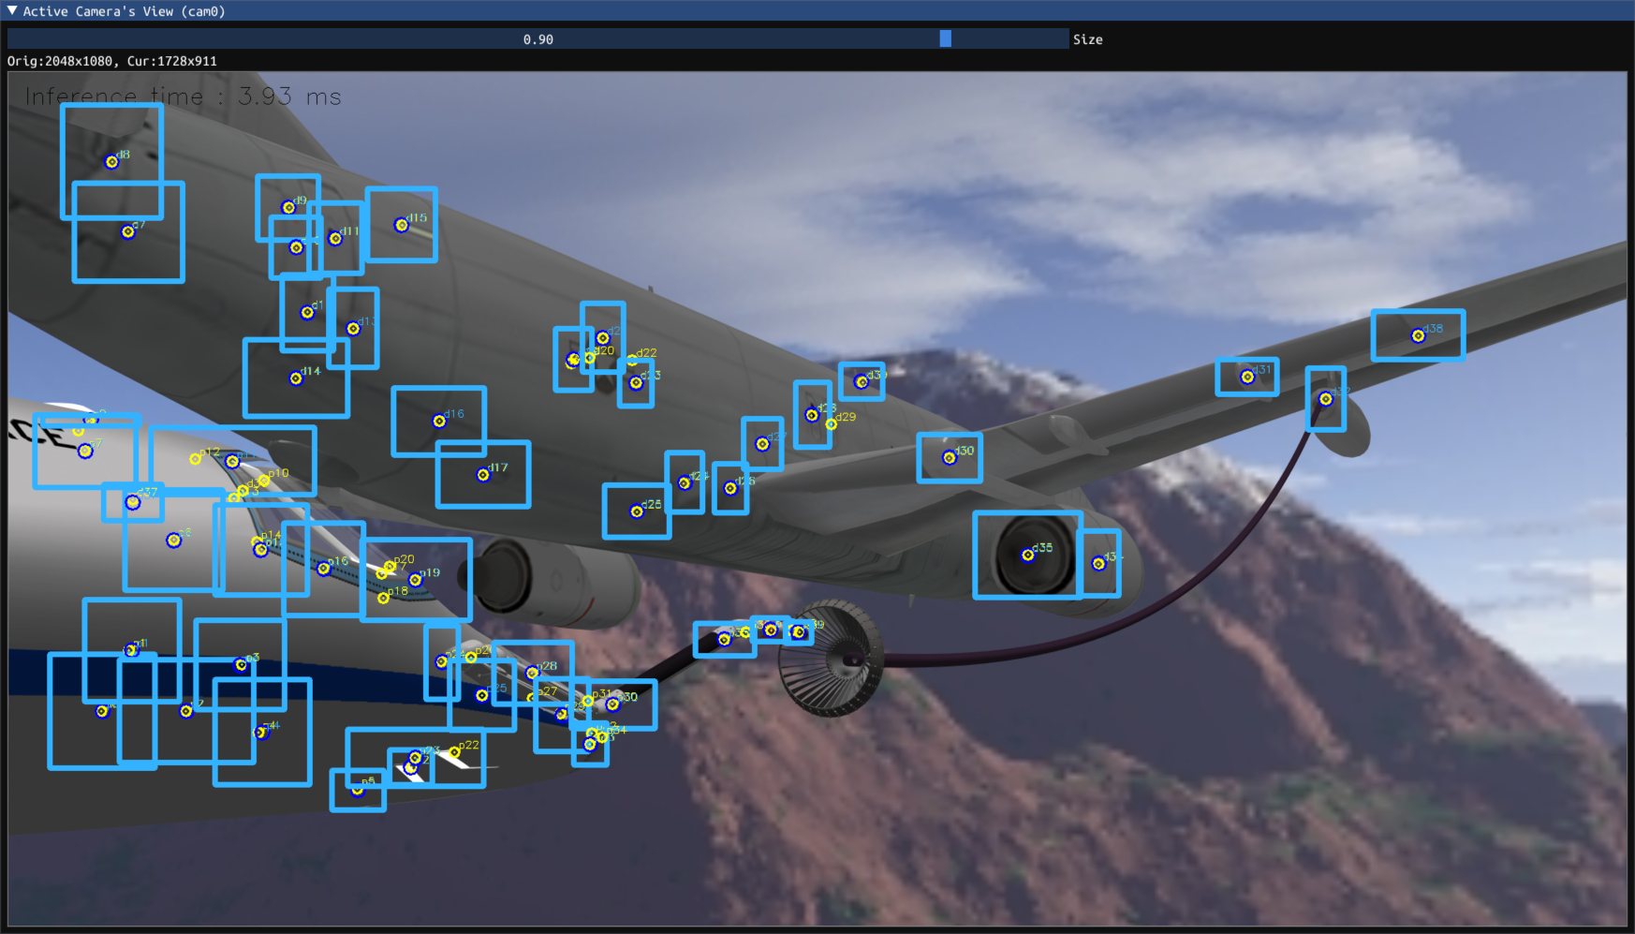
podcam1 (zoomed in)
podcam2 (zoomed out)
dashcam
d12
d13
corrected bounding boxes
uncorrected bounding boxes
random features
small features
medium features
large features

Slide 10
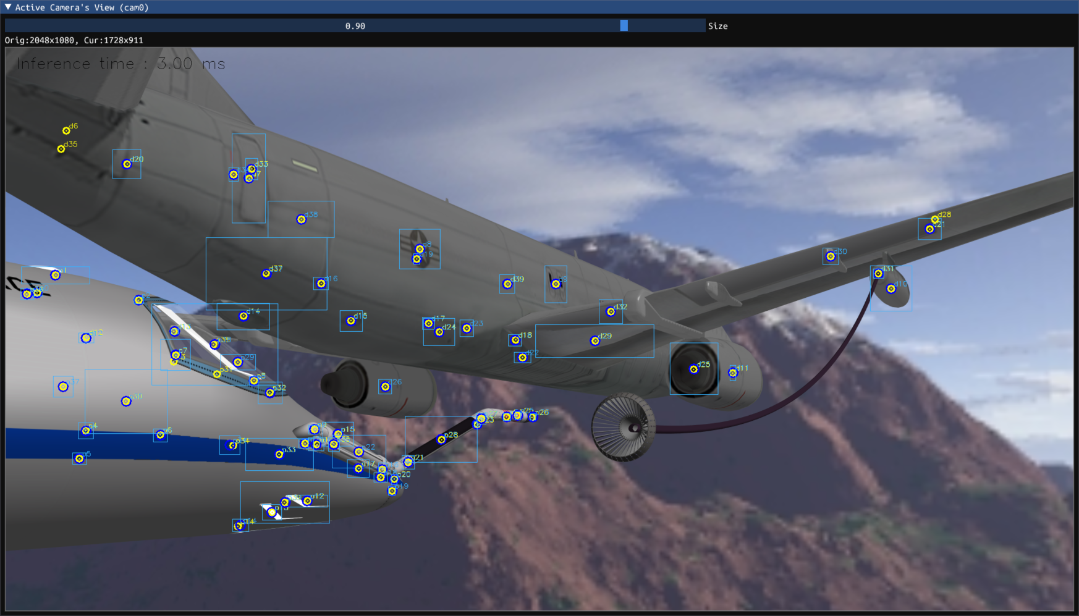
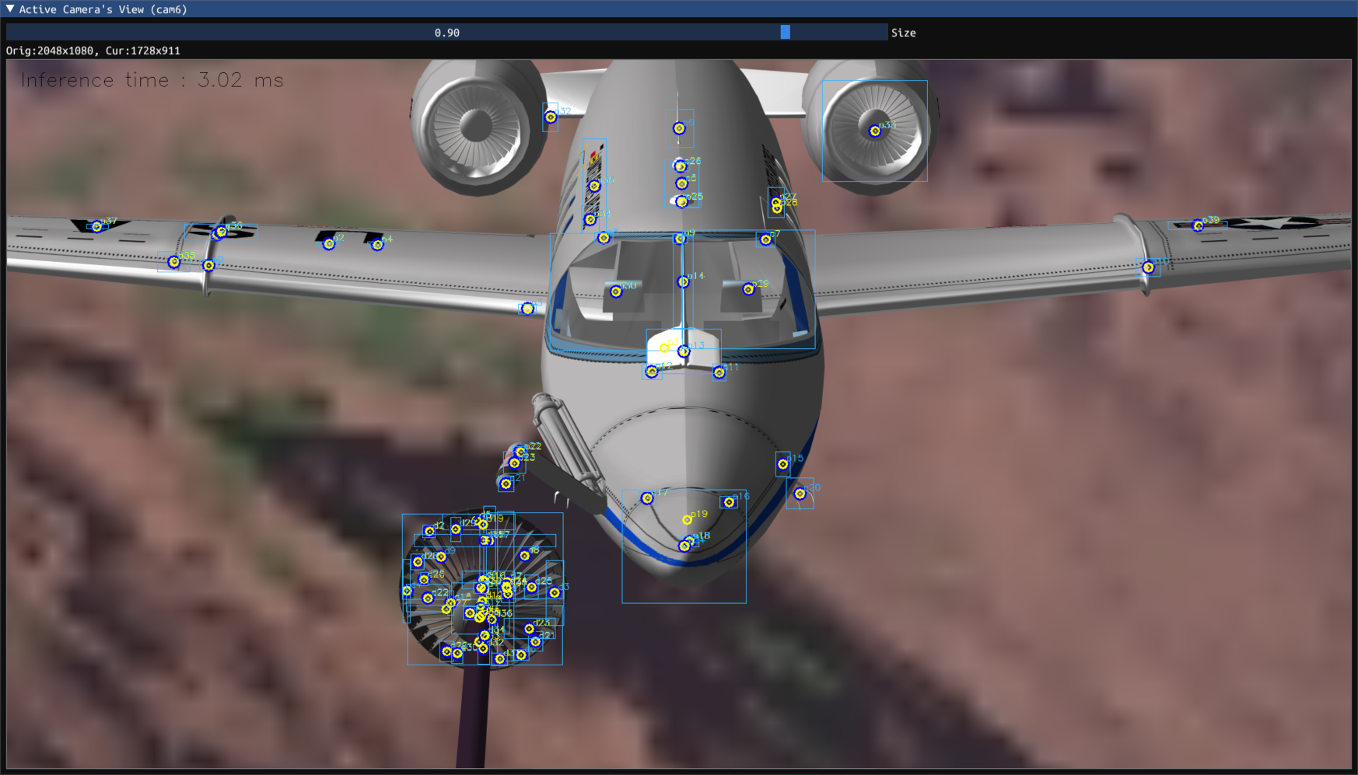
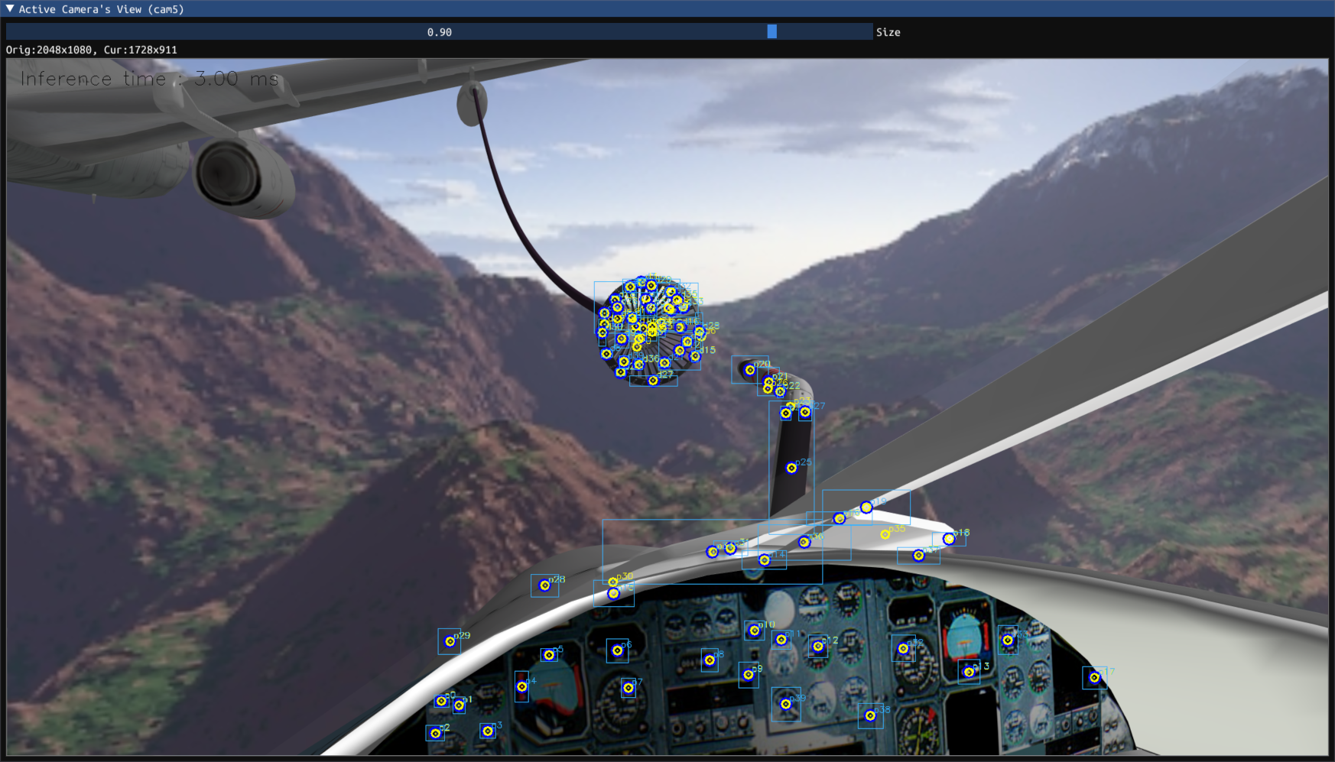
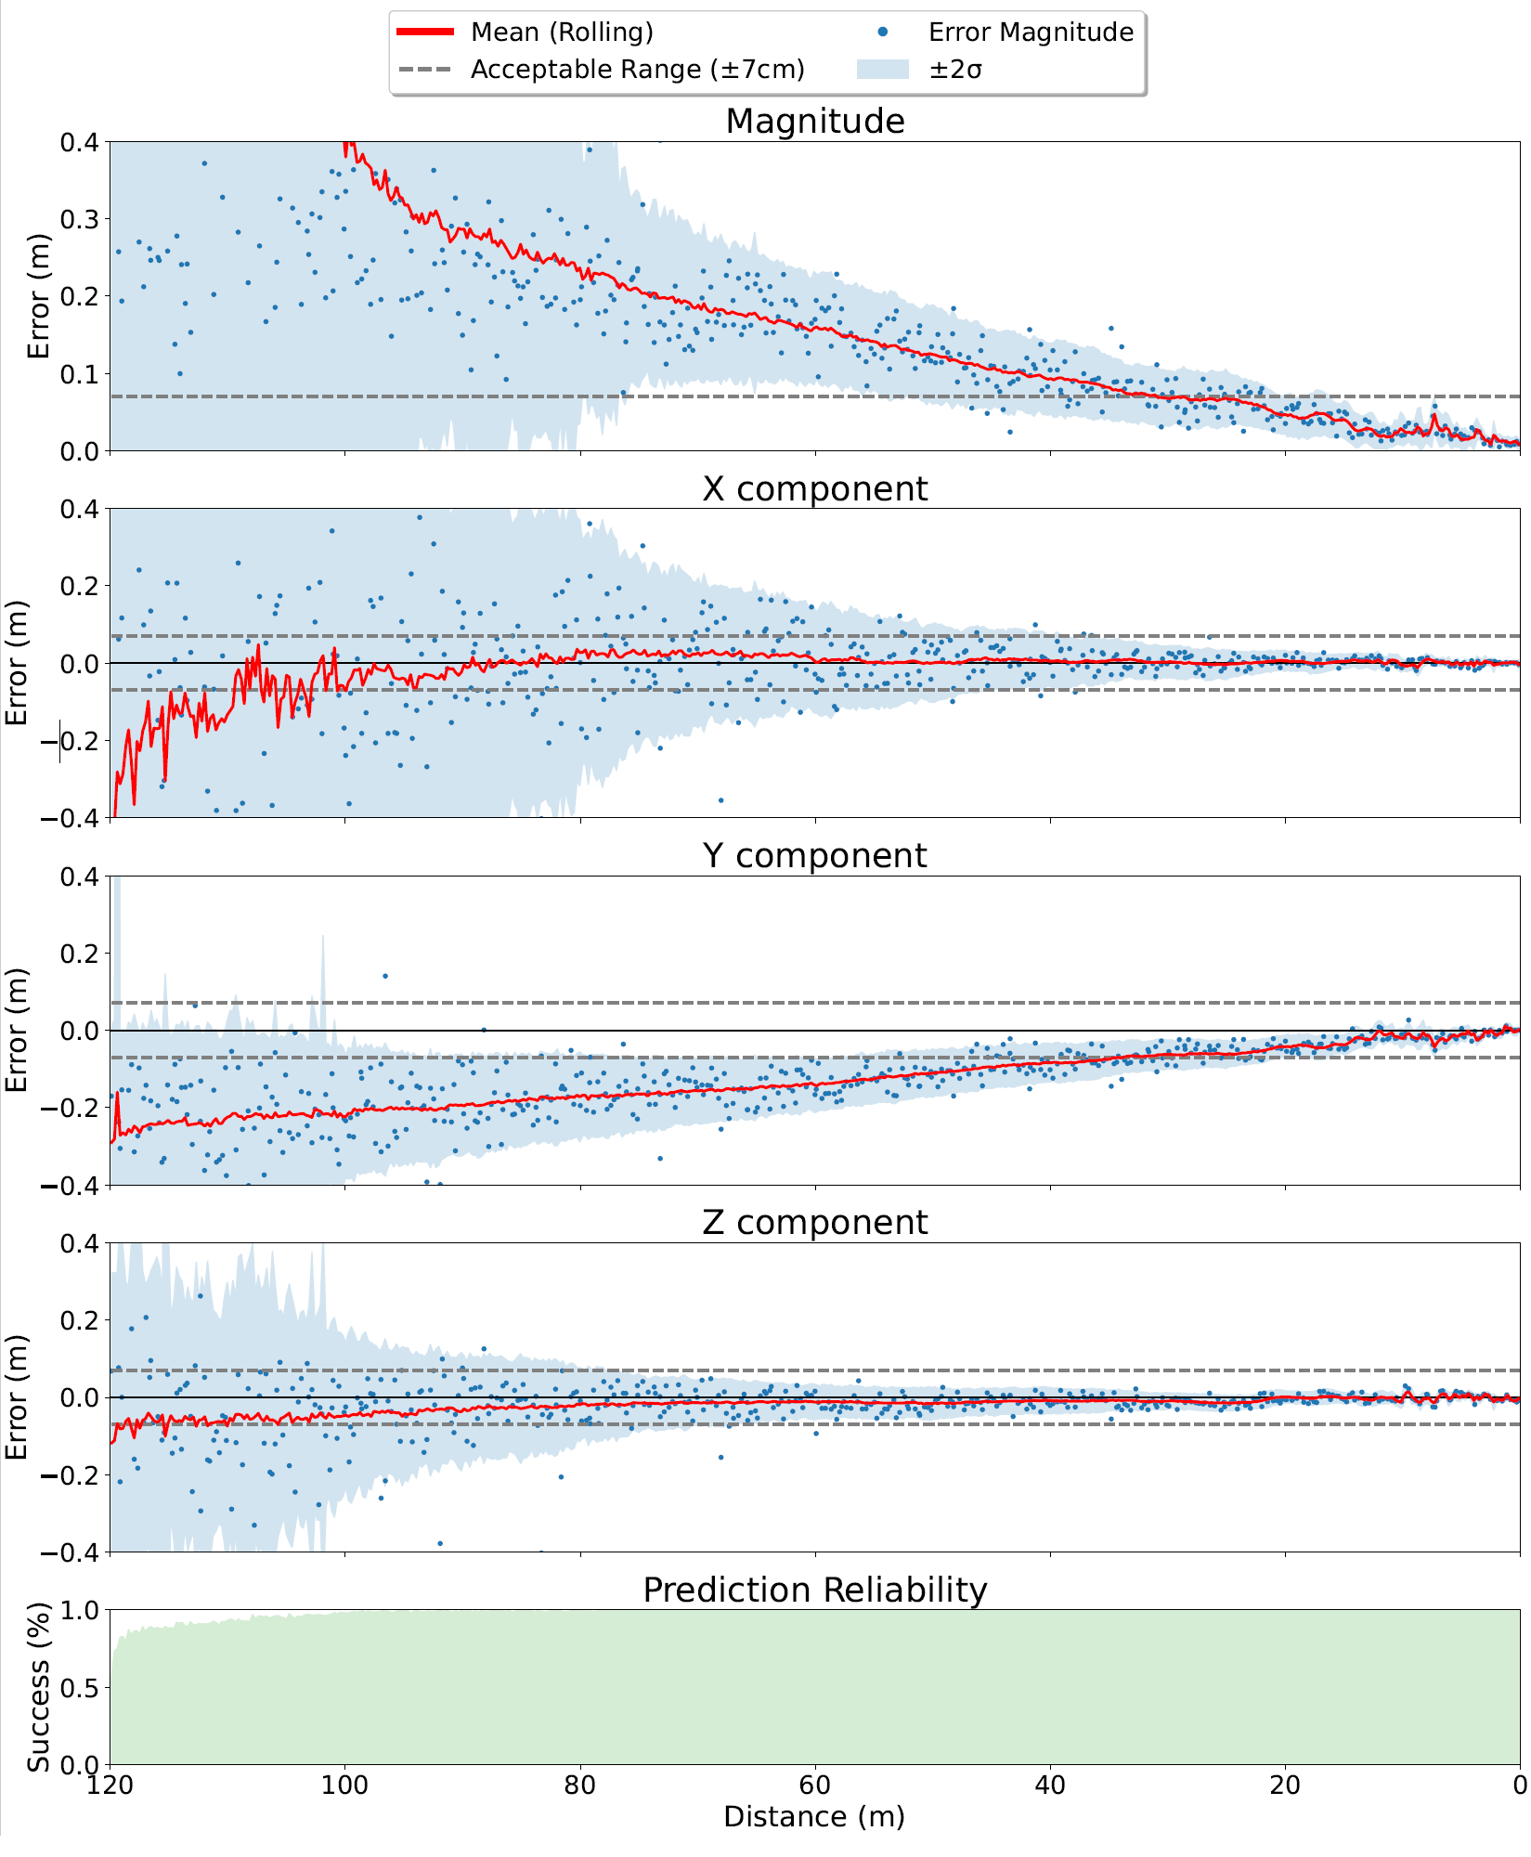
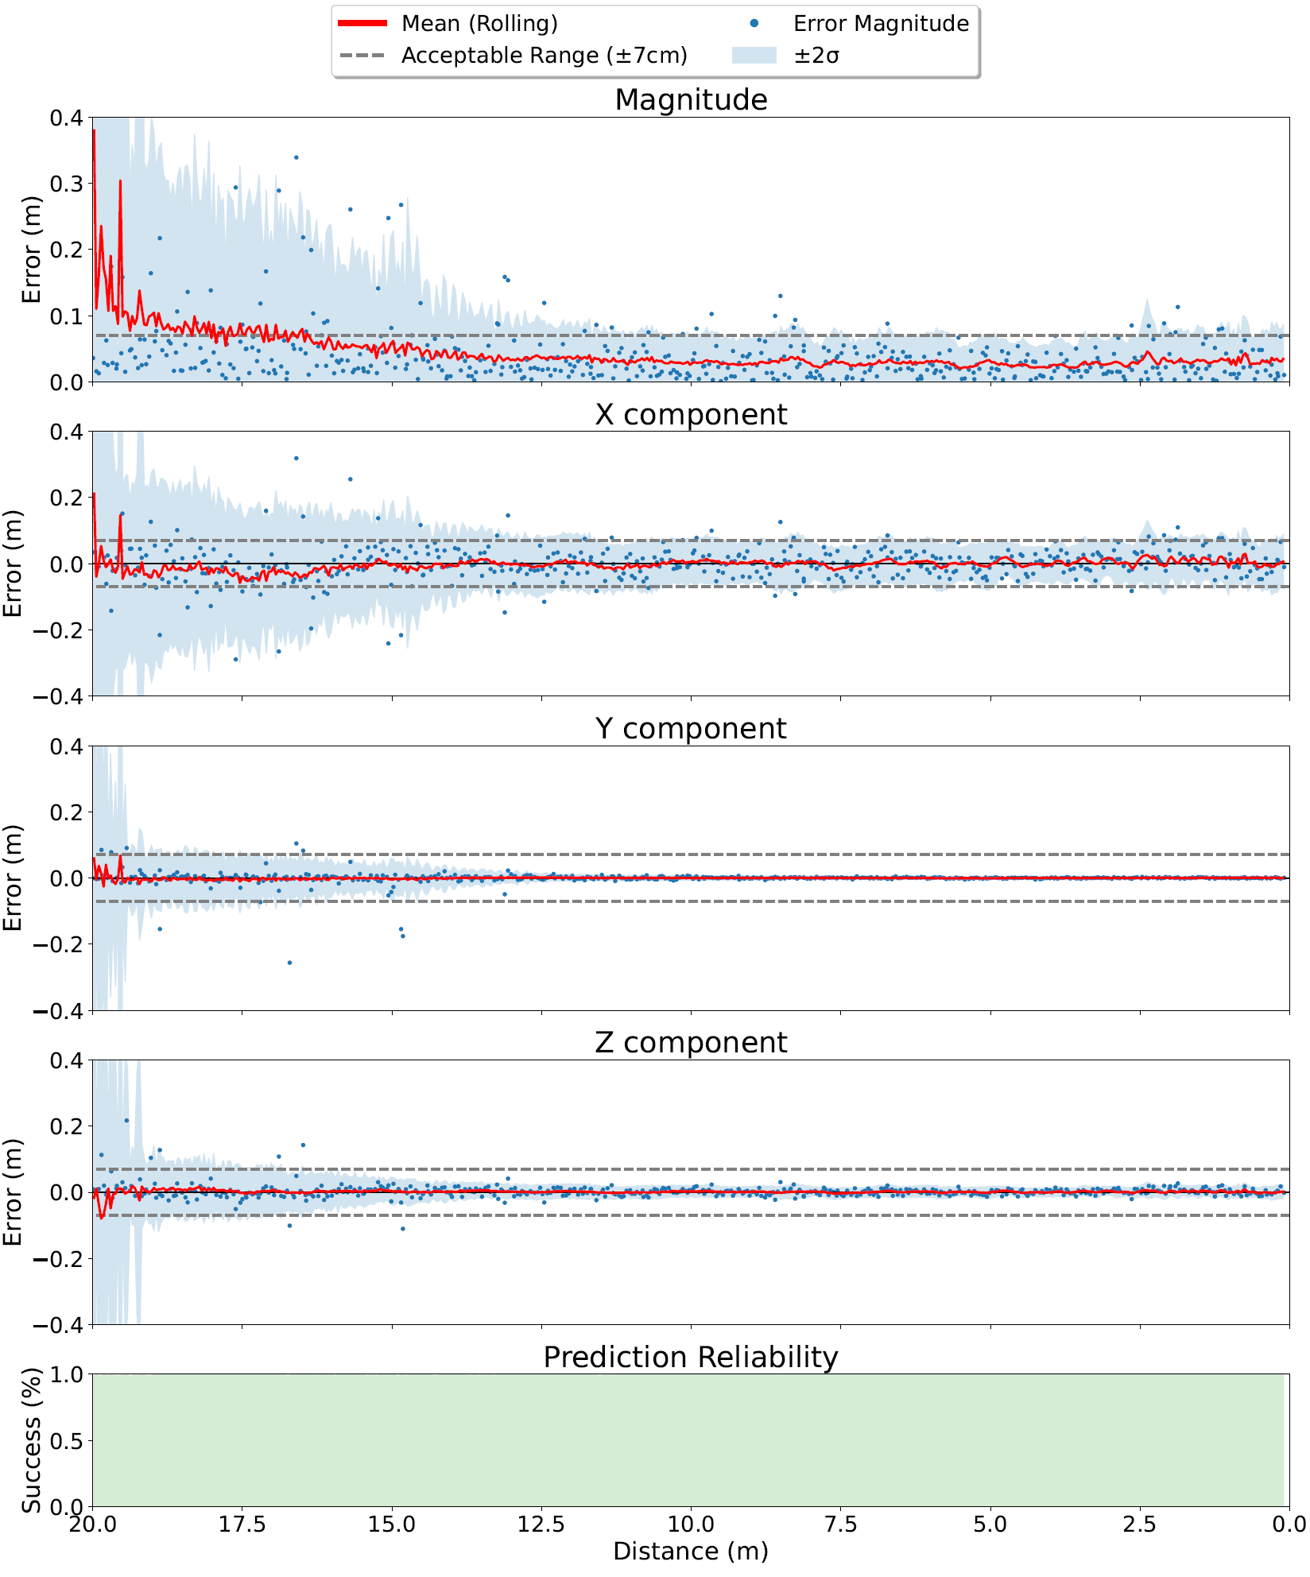
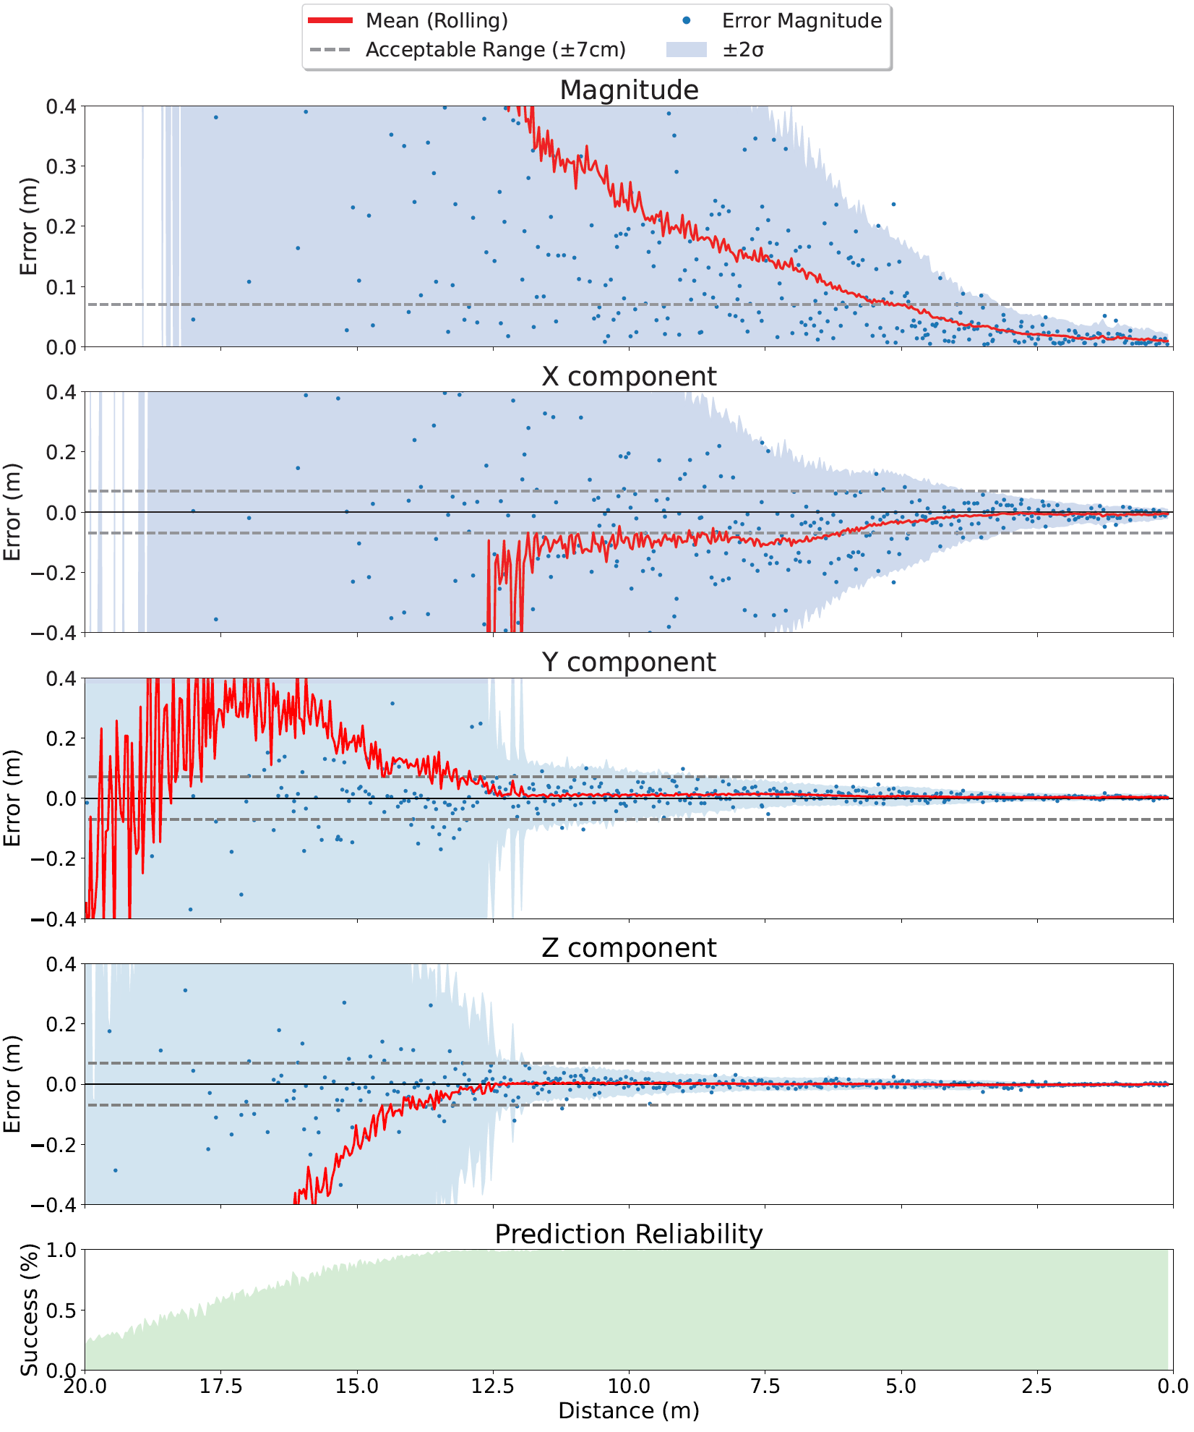
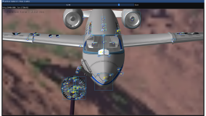

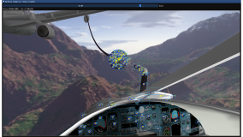
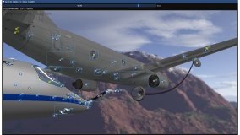
wingcam
podcam (zoomed in)
dashcam

Slide 11
Annotation Automation in Real Imagery
MoCap Image Reprojections Using AprilTag Localization

Slide 12
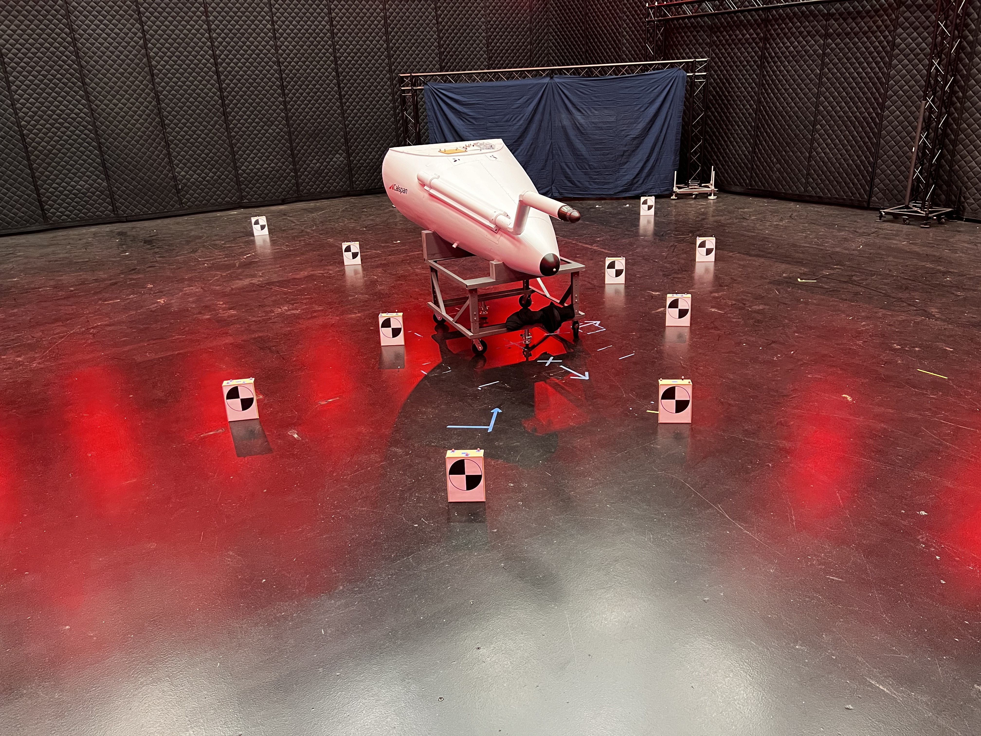
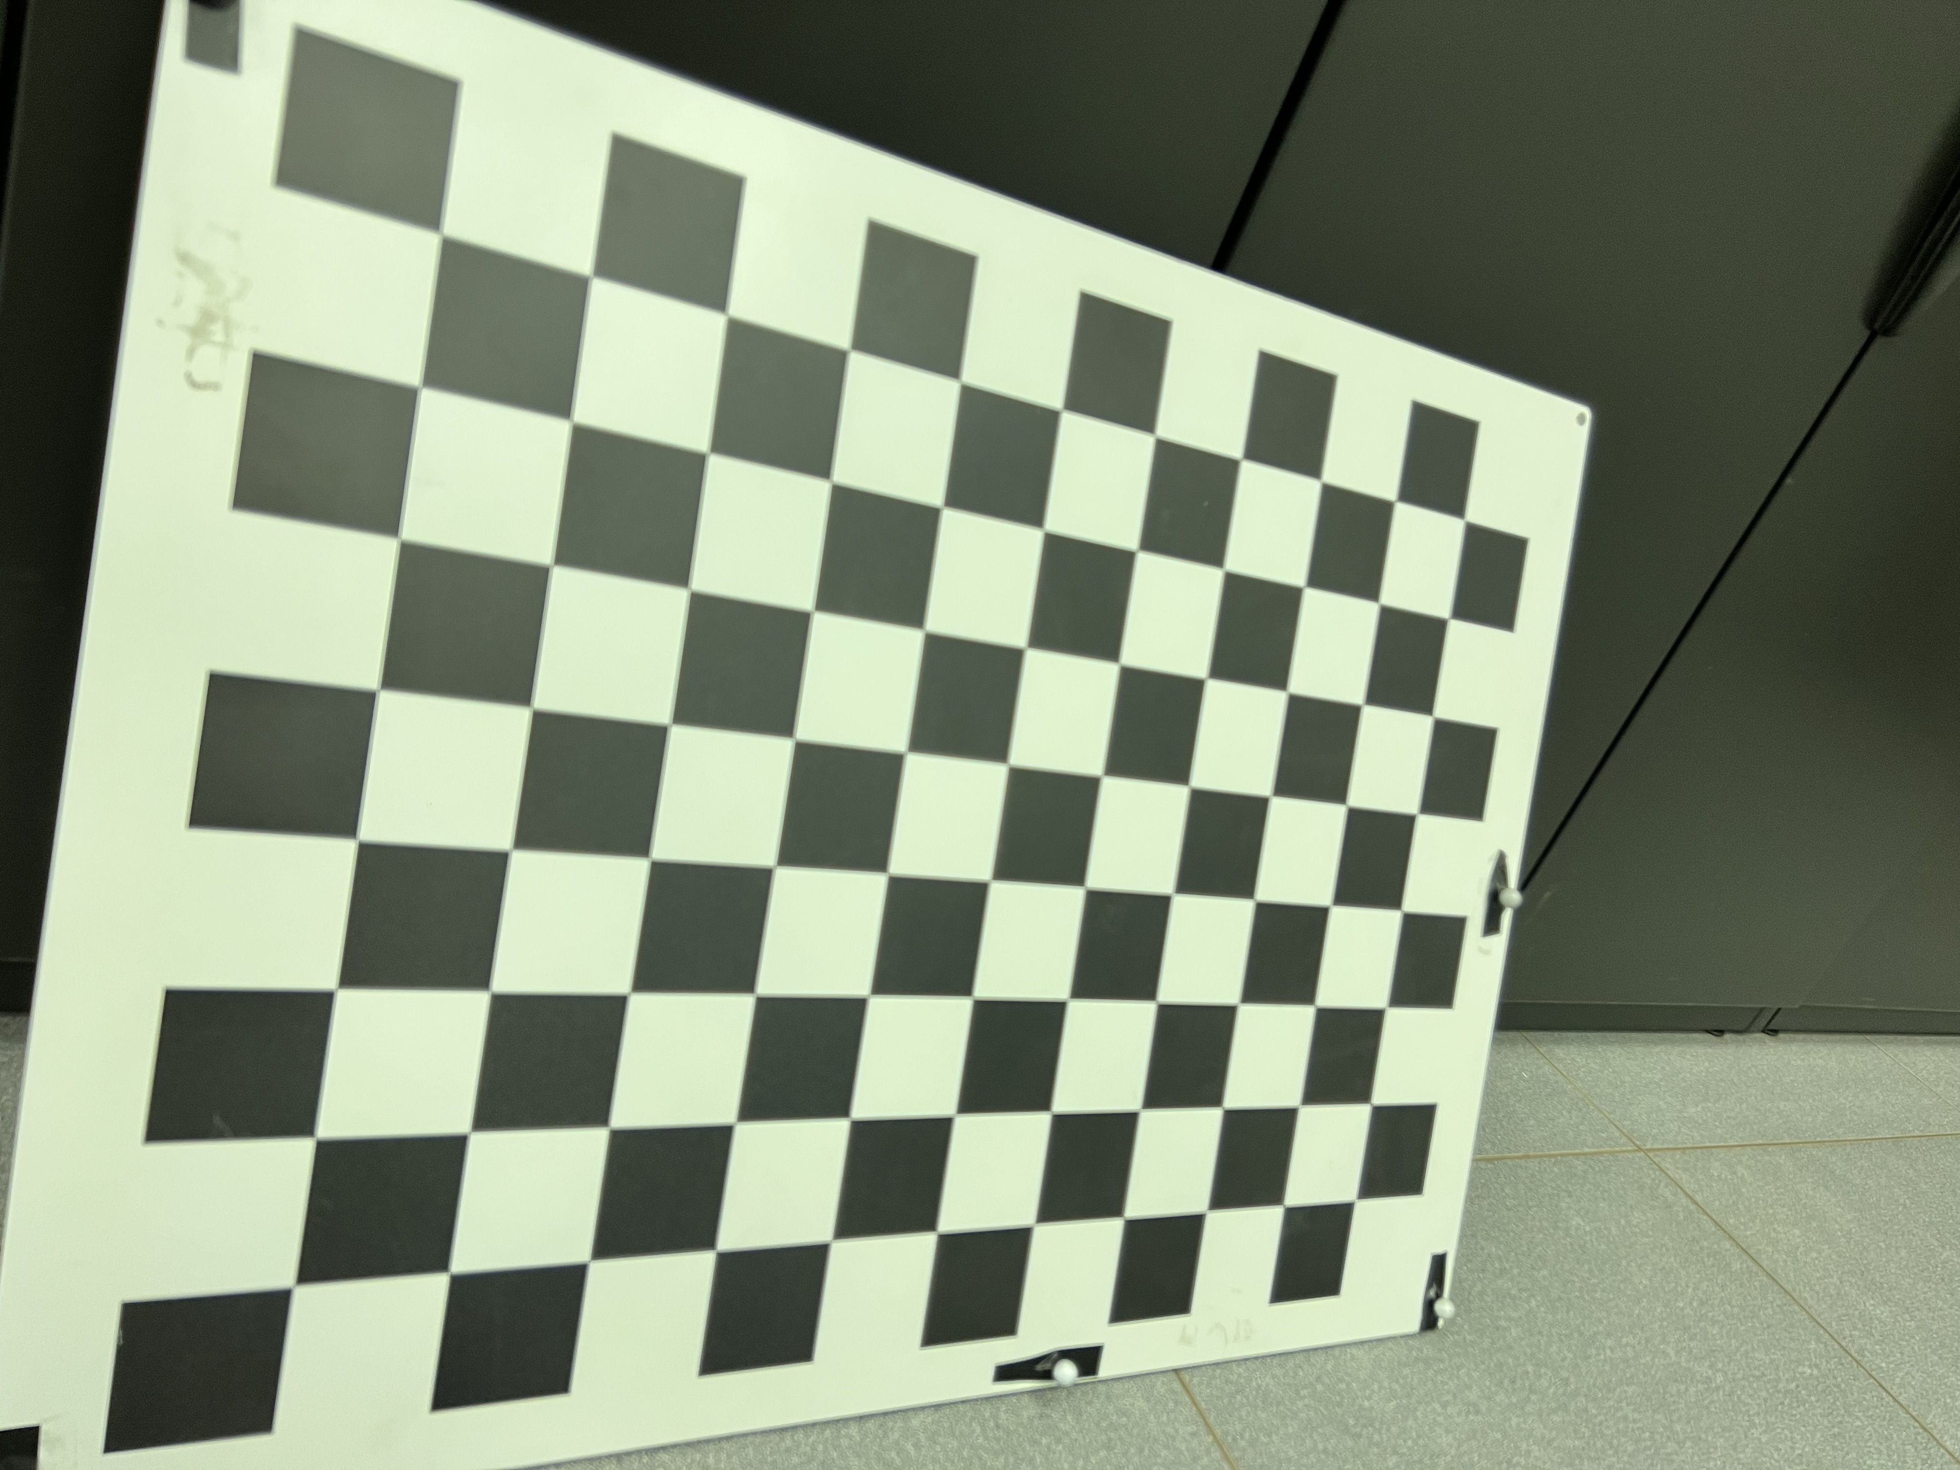
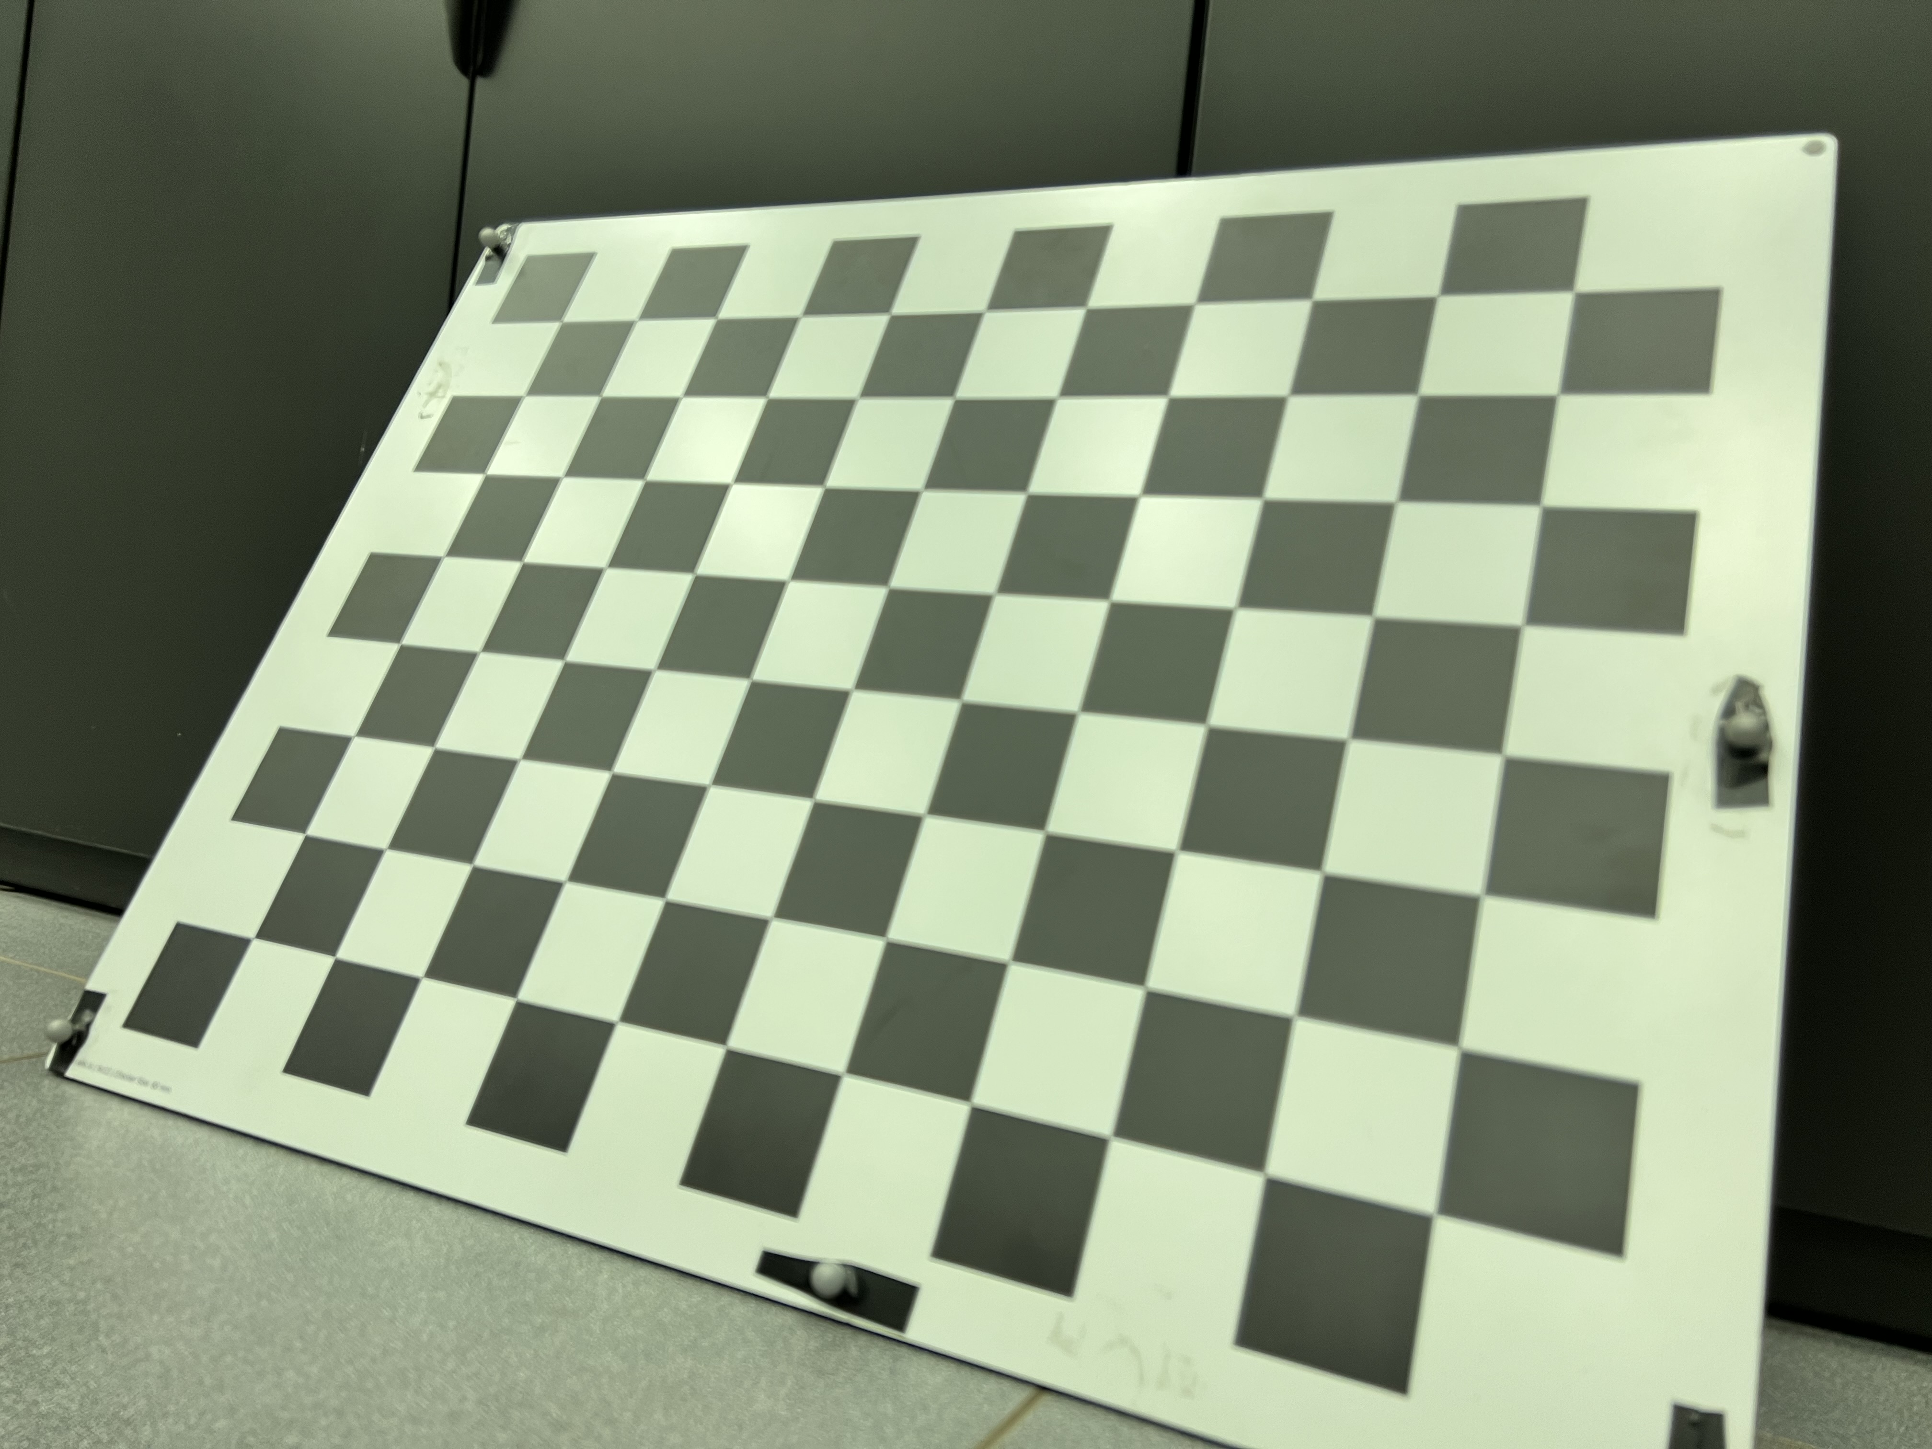
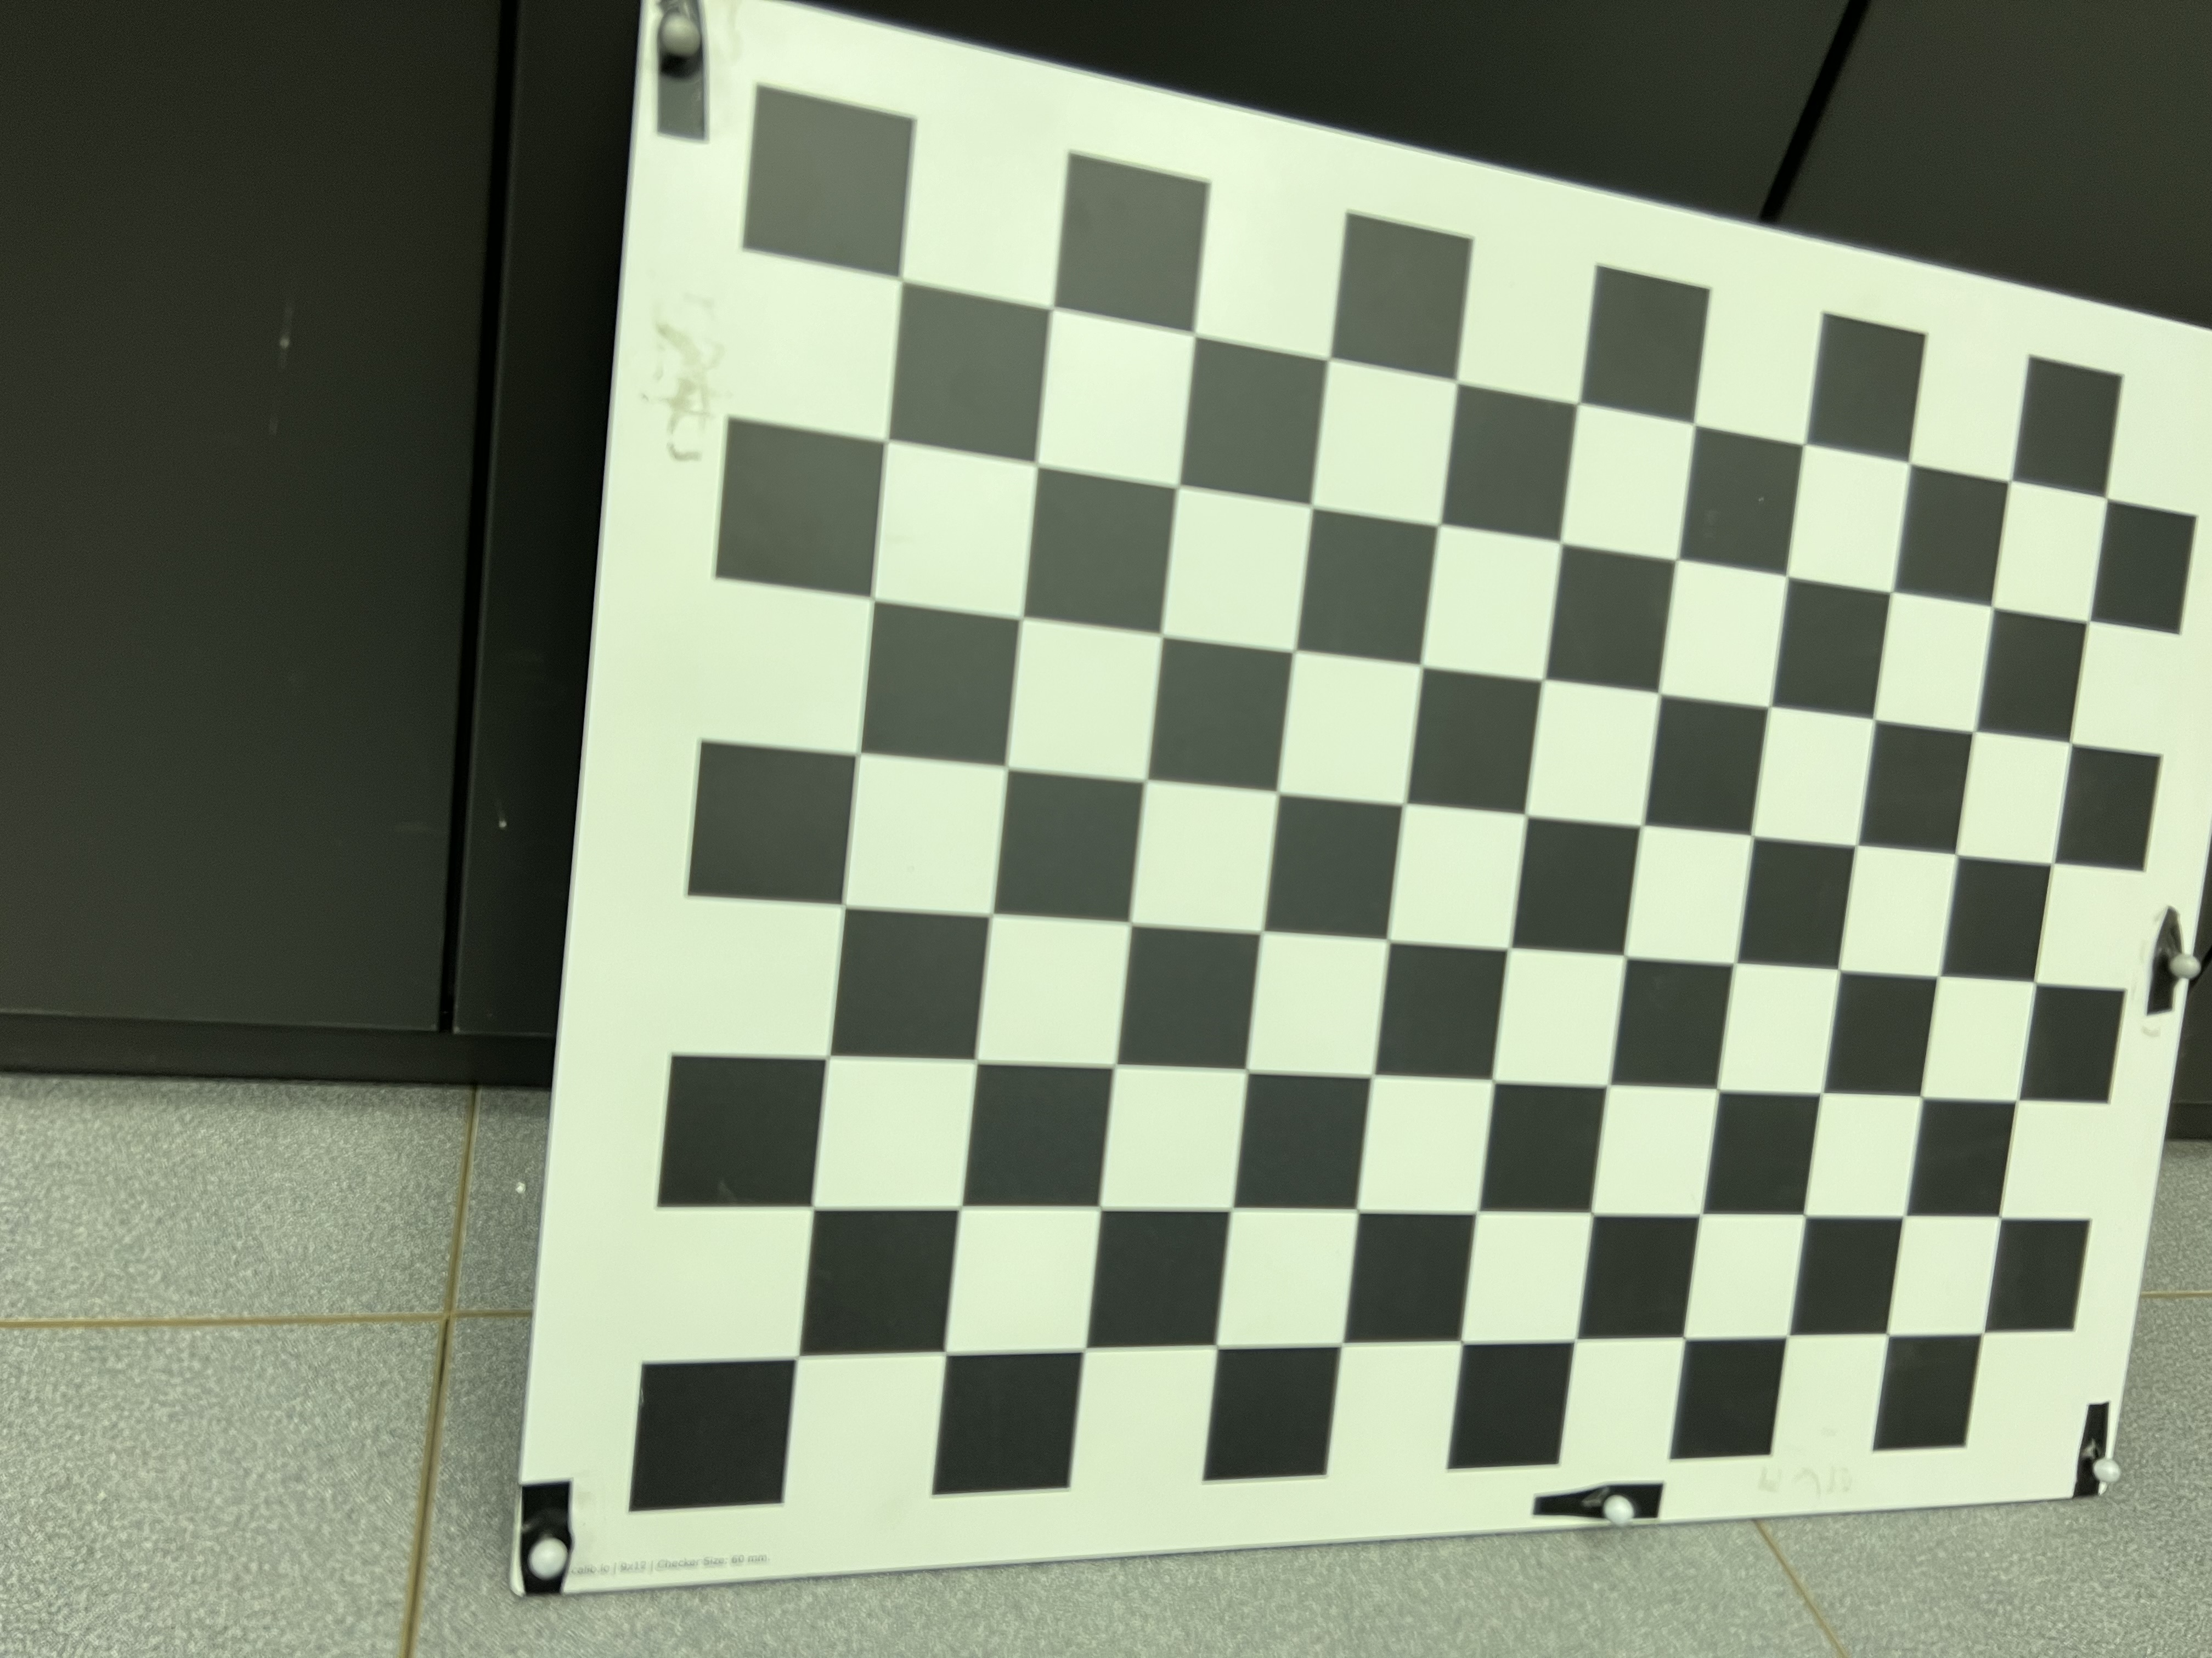
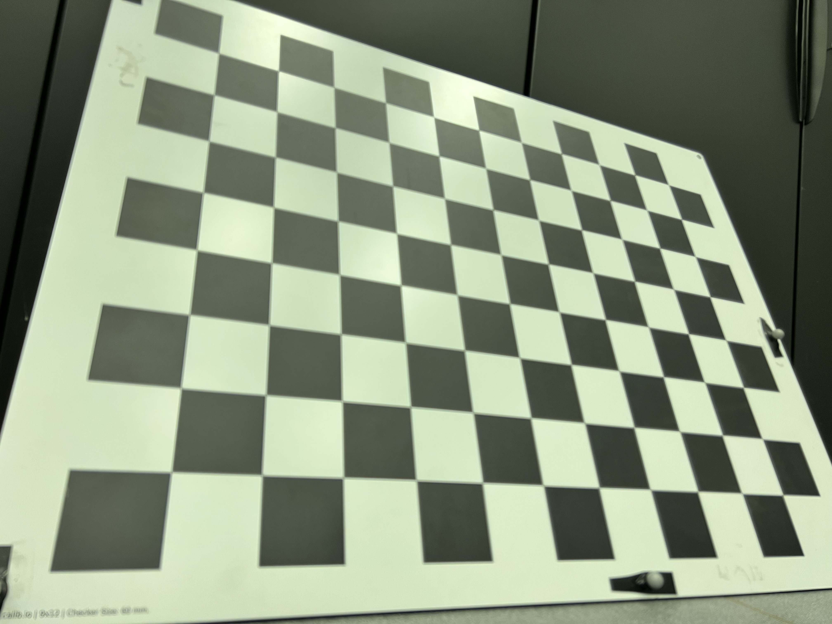
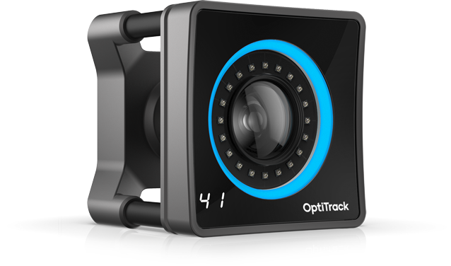

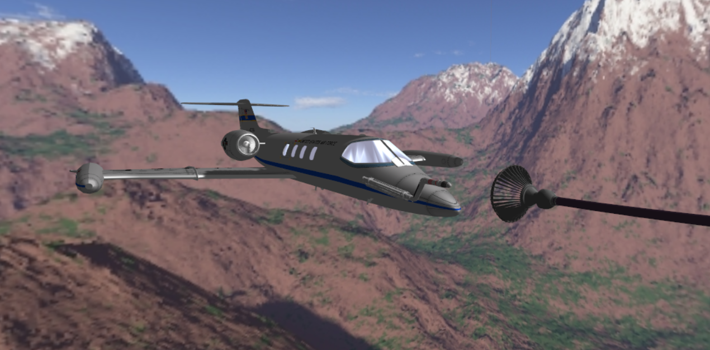
MoCap Image Re-projection
Camera
2D points
Solve
PnP
image capture
3D points
rvec
tvec
Camera Instrinsics
(from chessboard calibration)
Fiducial targets
3D points
marker
balls
Project
Points
marker
balls
3D points
motion capture
Learjet nose cone
MCS
2D points
2D points
2D points
Digital Twin
Reprojections back into
original image

Slide 13
Applying to Real Imagery

Slide 14
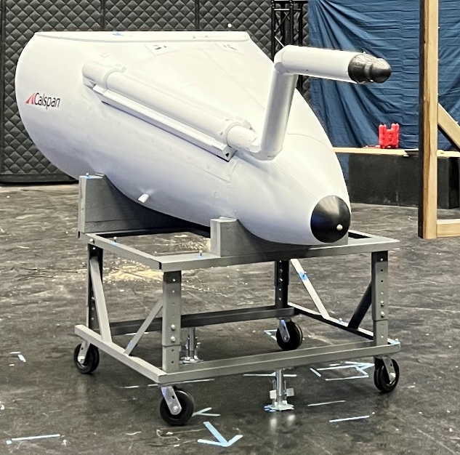
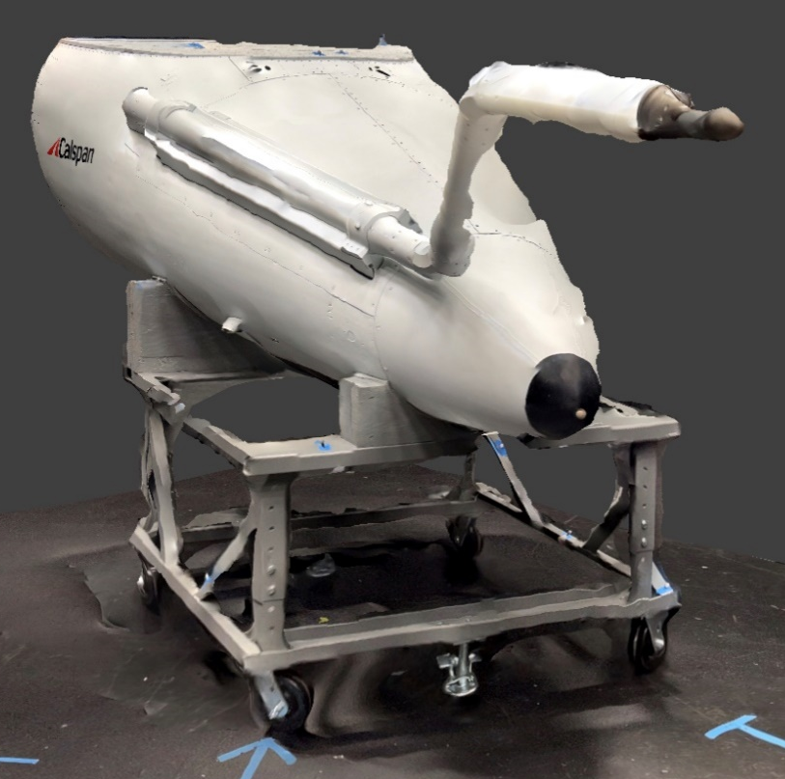
Machine Transfer Learning
Scene Augmentation
Background
Lighting
Perspective
Orientation
Cameras:
Alvium G5 811c
Insta360 Link
Hybrid
(AR)
3D
Scans
Virtual
world
Real
world
MoCap Image
Re-projection
Label Generation
Relative Vectoring
Using predictions on real imagery
Optimize:
Bounding box corrections
Feature selection
Optimize:
Model size
Image input size
Model Training

Slide 15
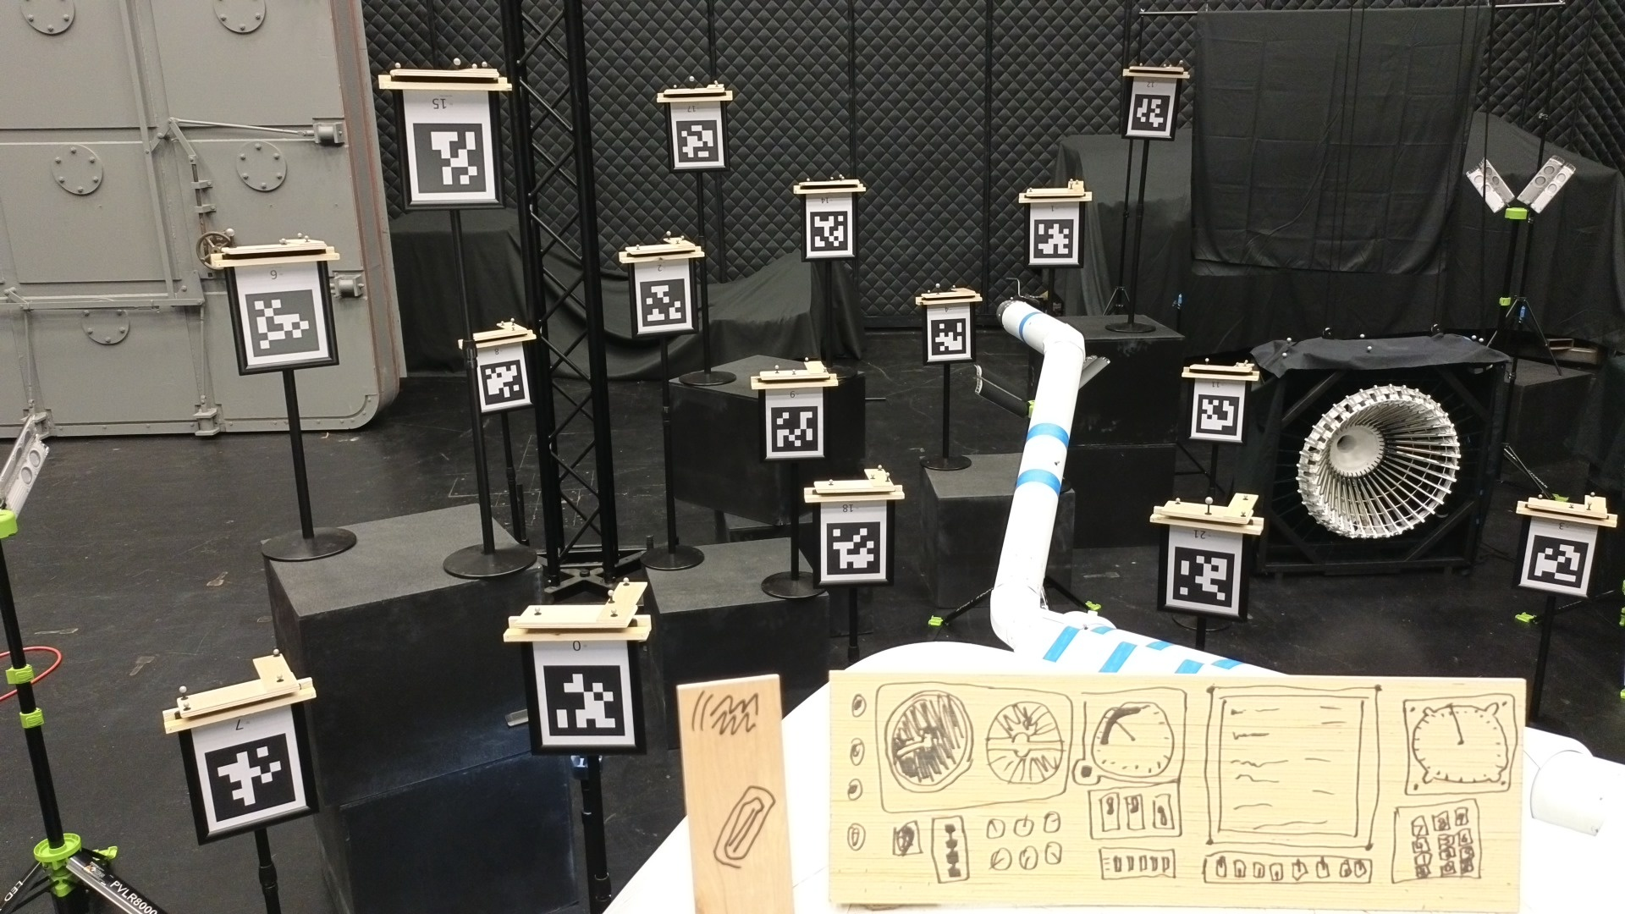

Slide 16
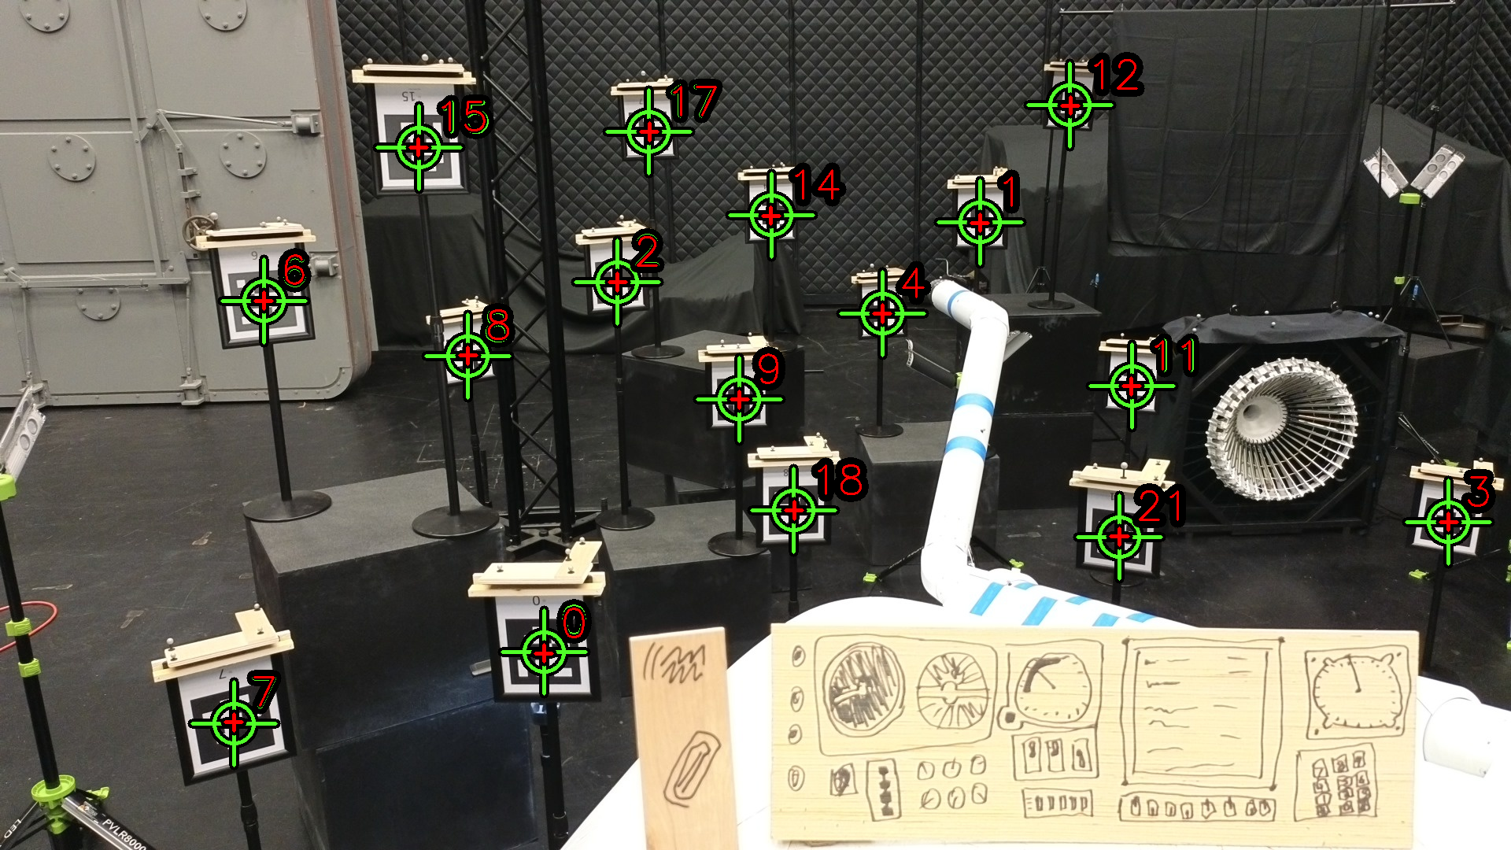

Slide 17
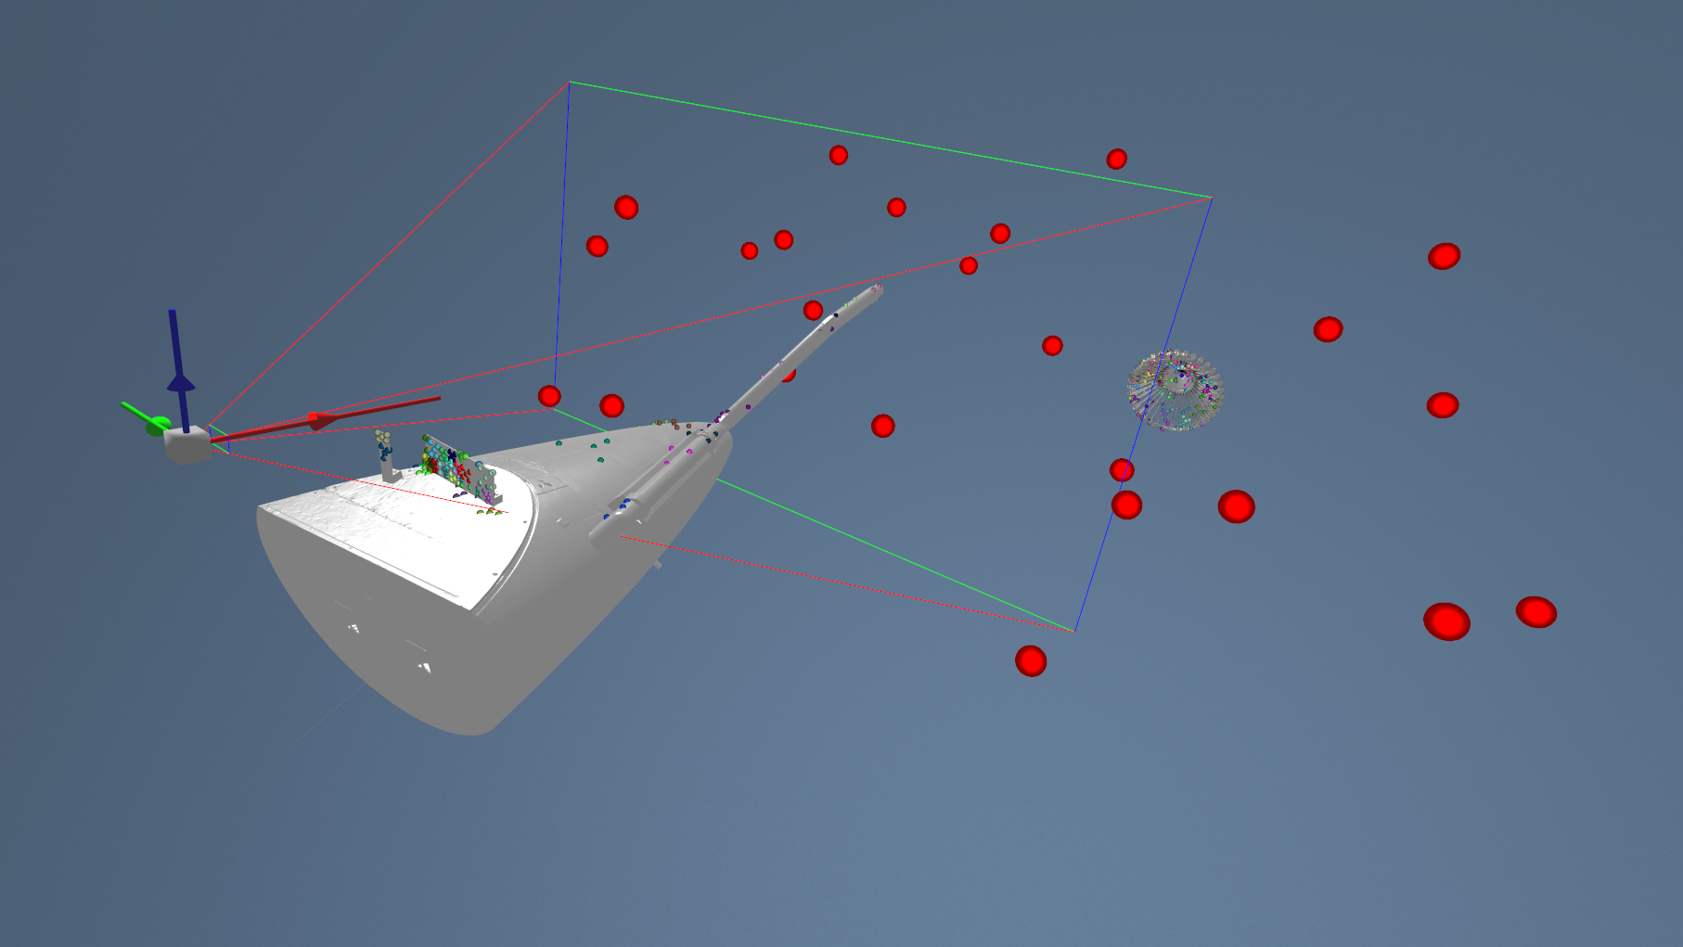
Digital Twin

Slide 18
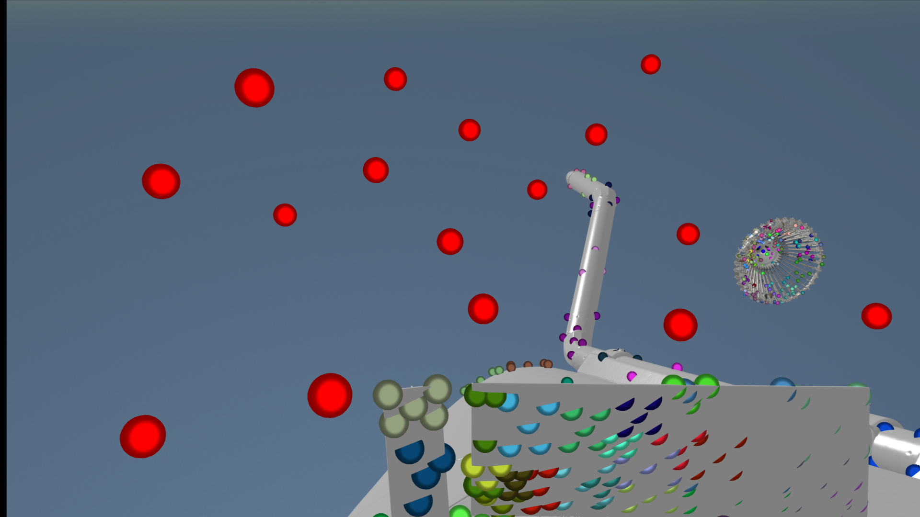

Slide 19
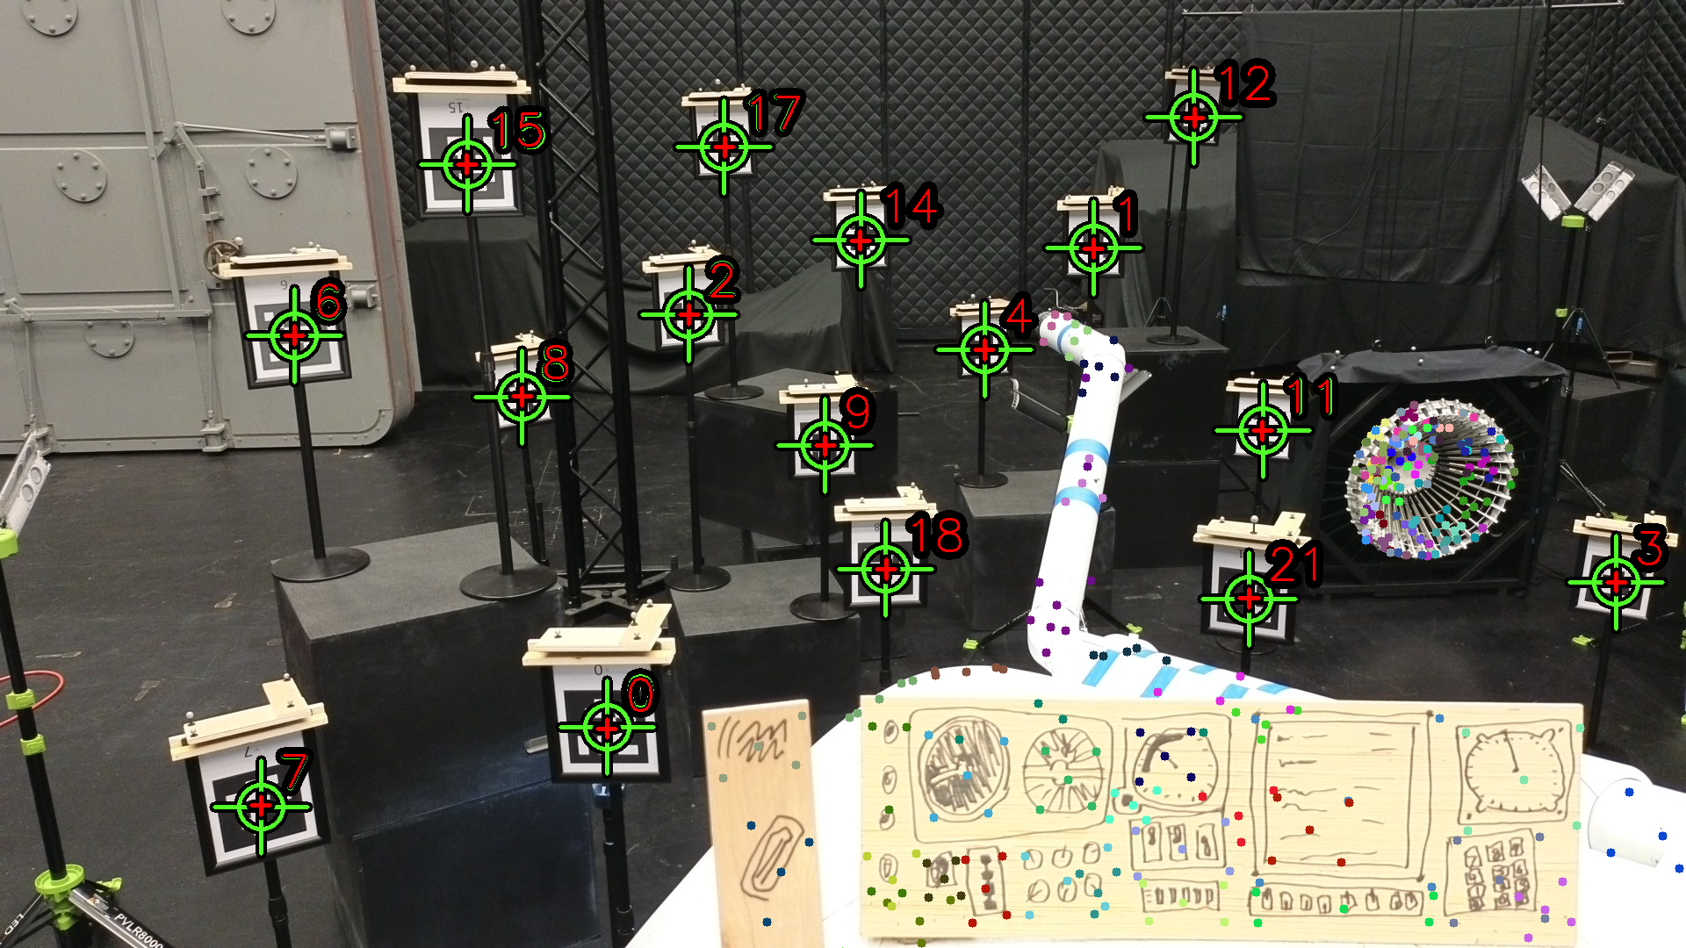

Slide 20
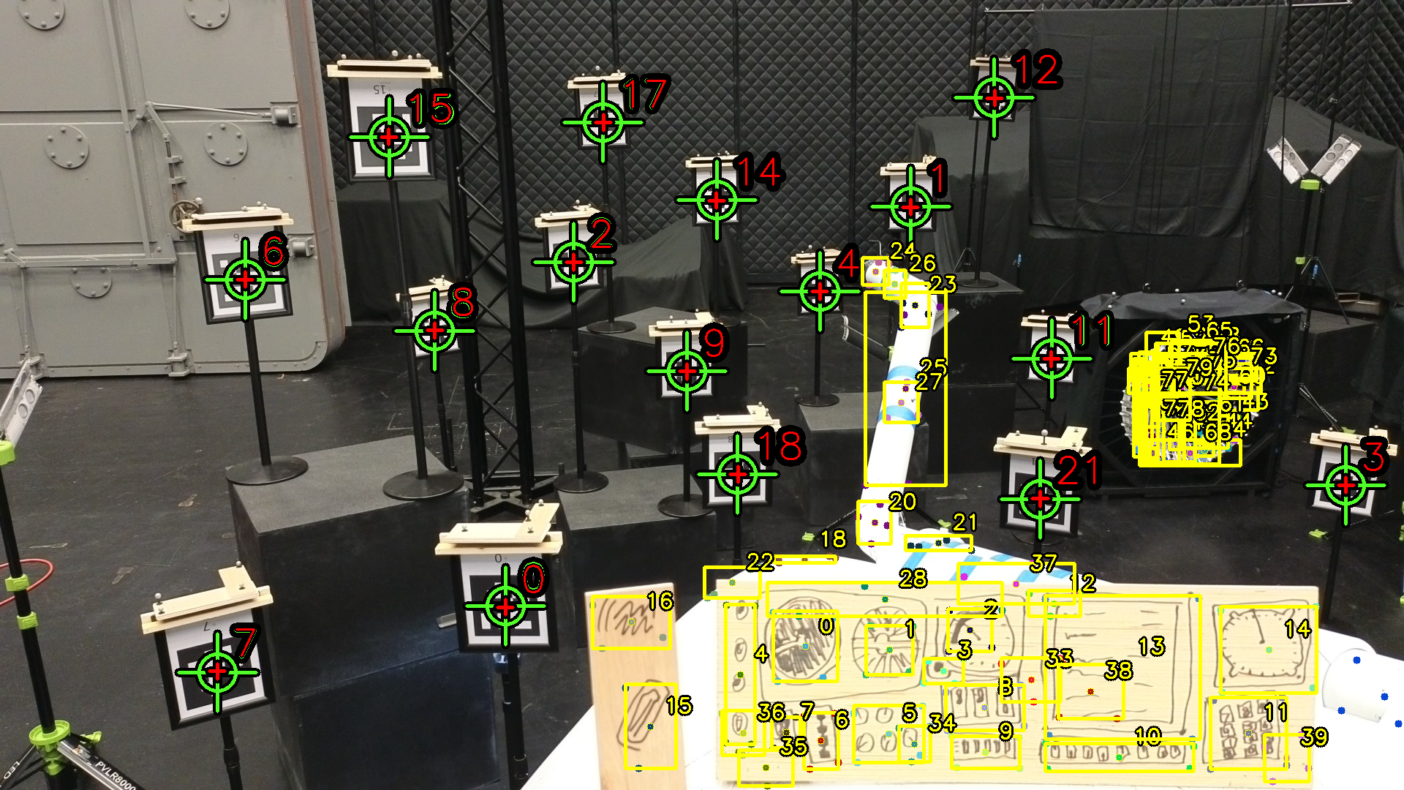

Slide 21
Flight Test Training
Augmenting virtual and lab imagery with real flight test imagery

Slide 22
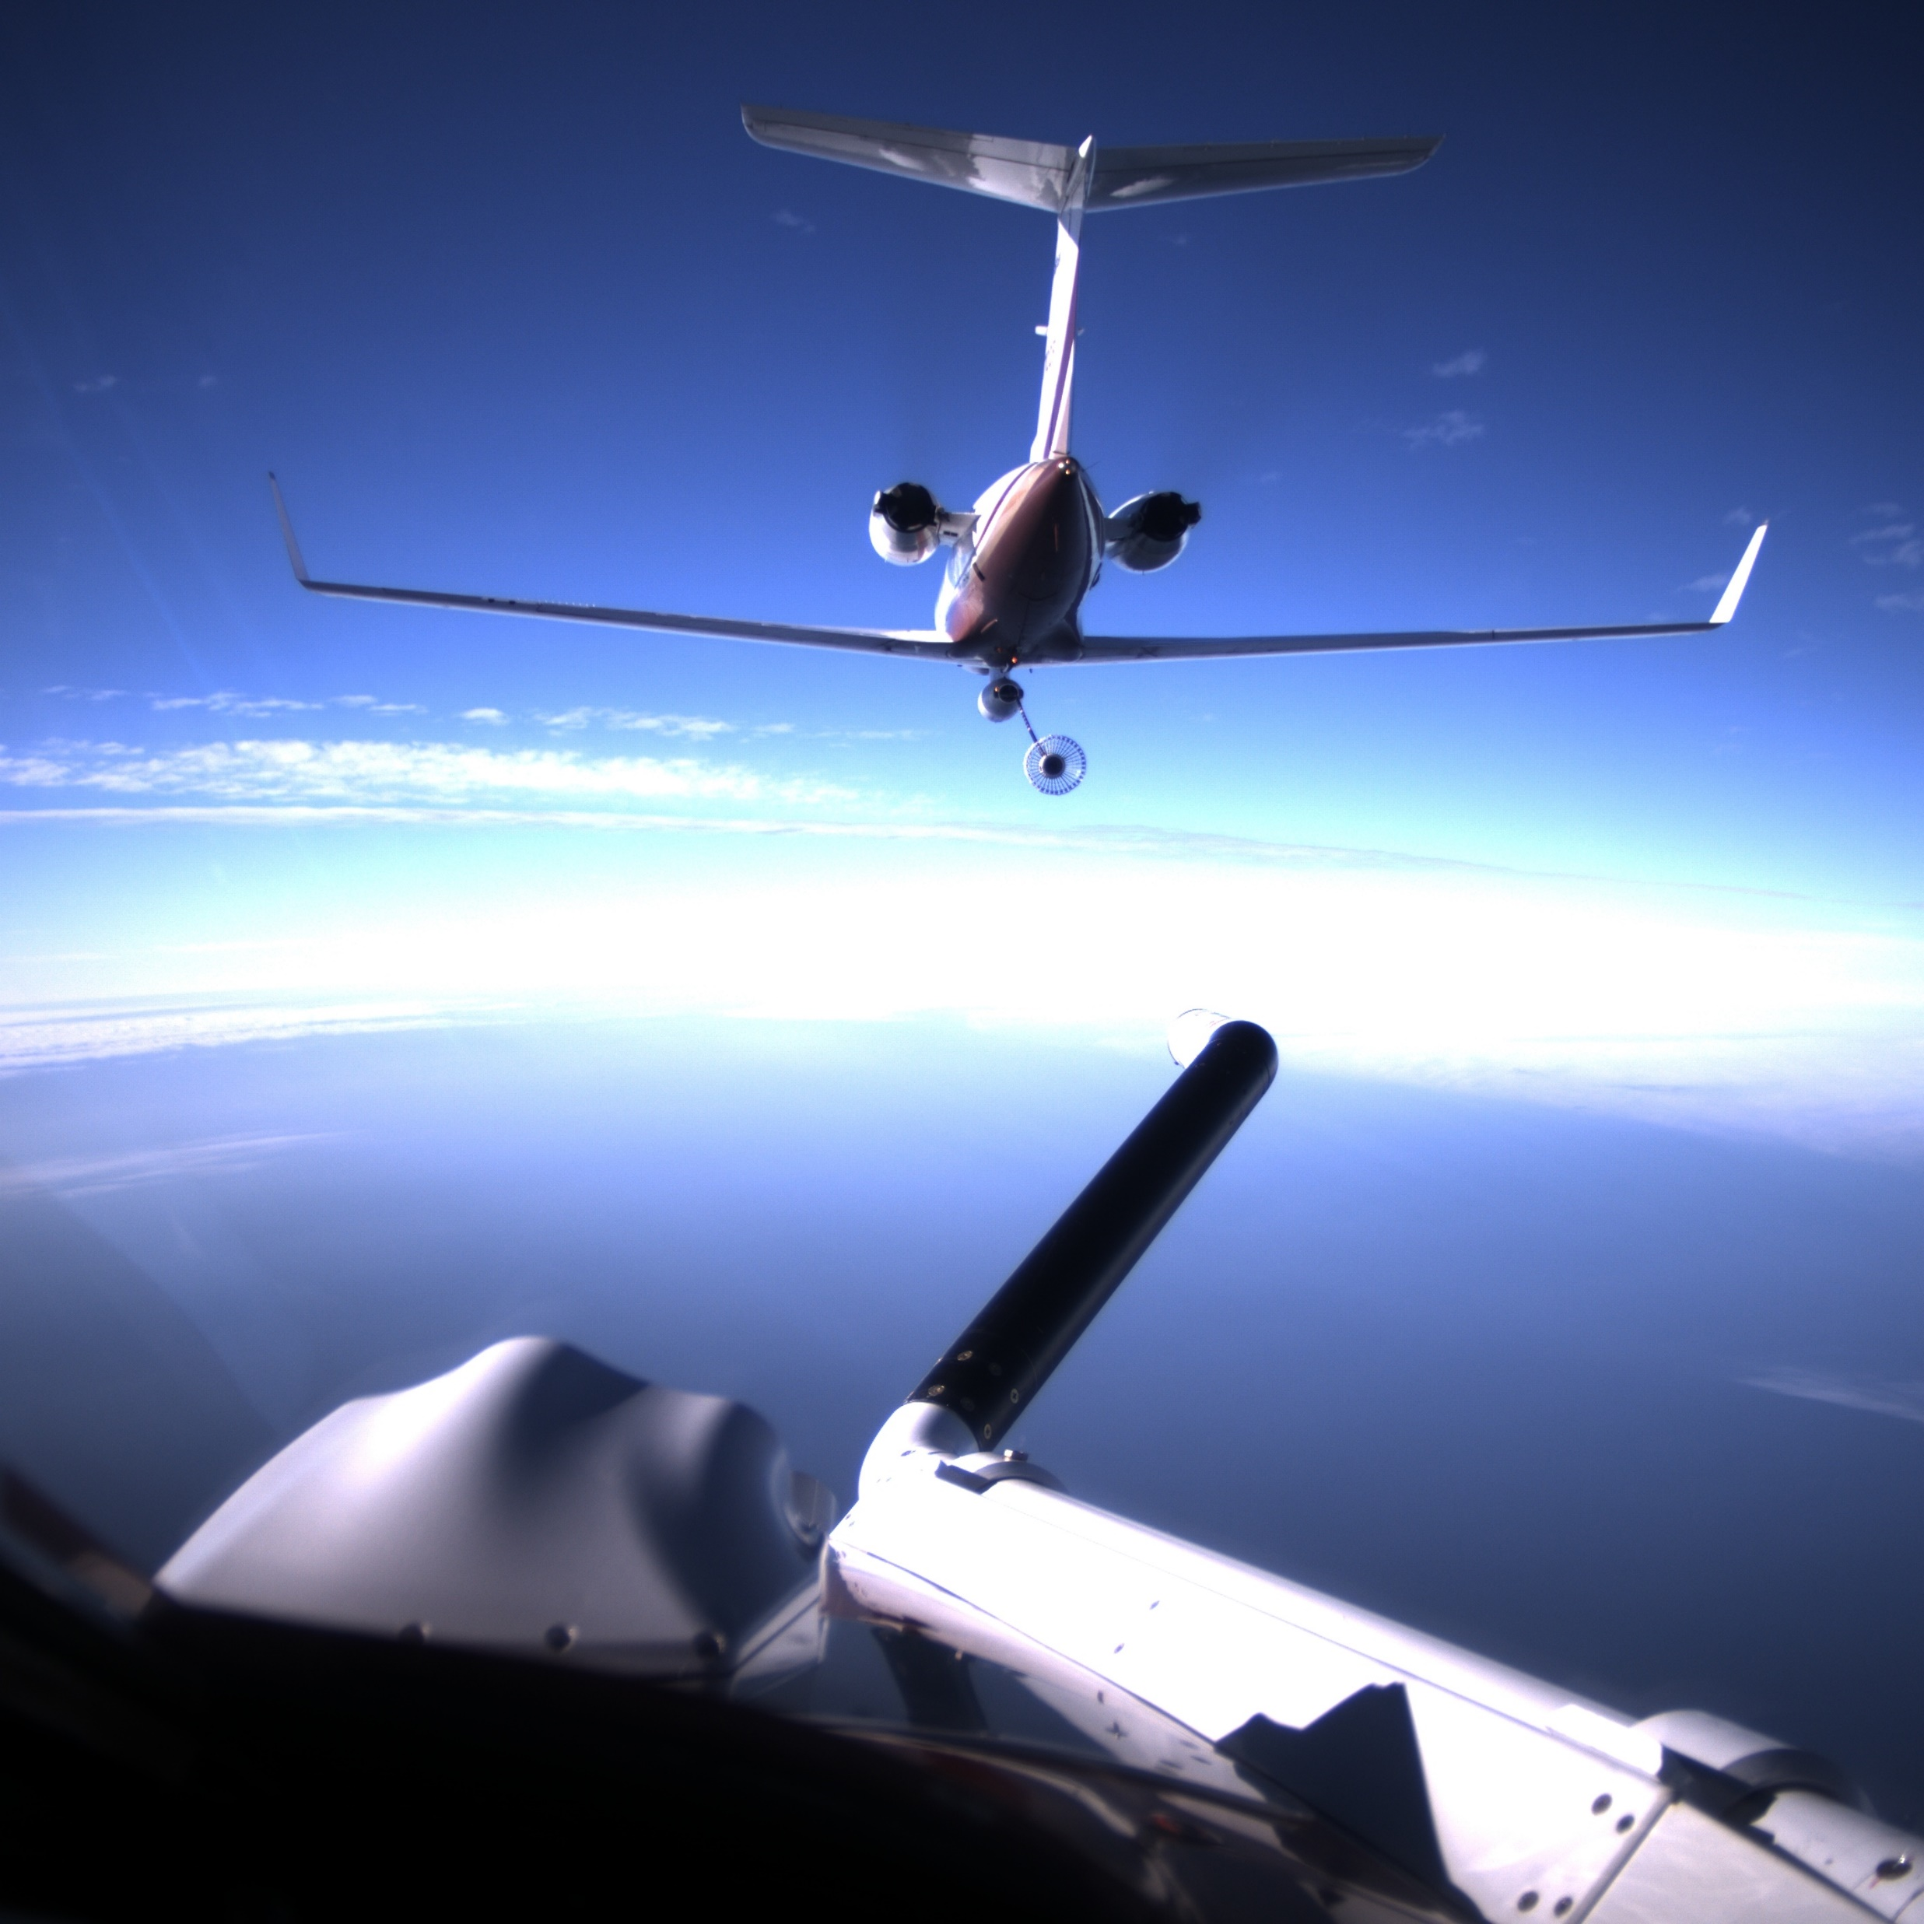
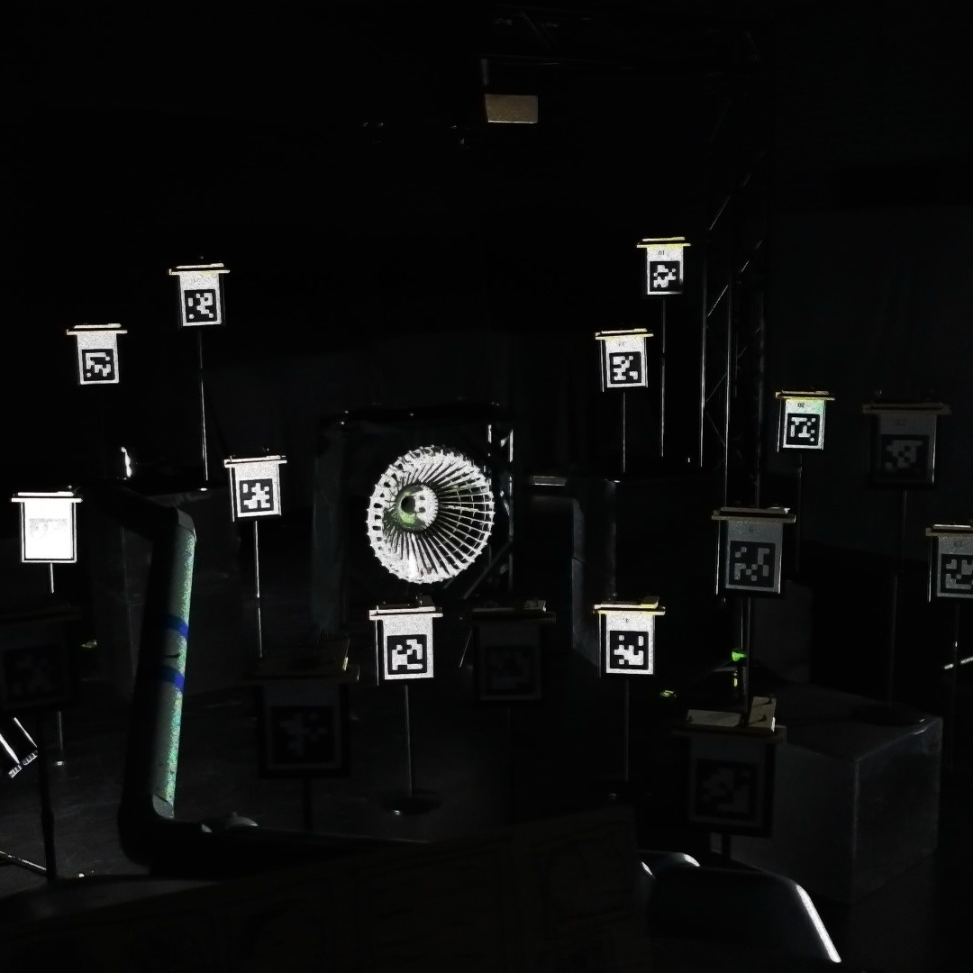
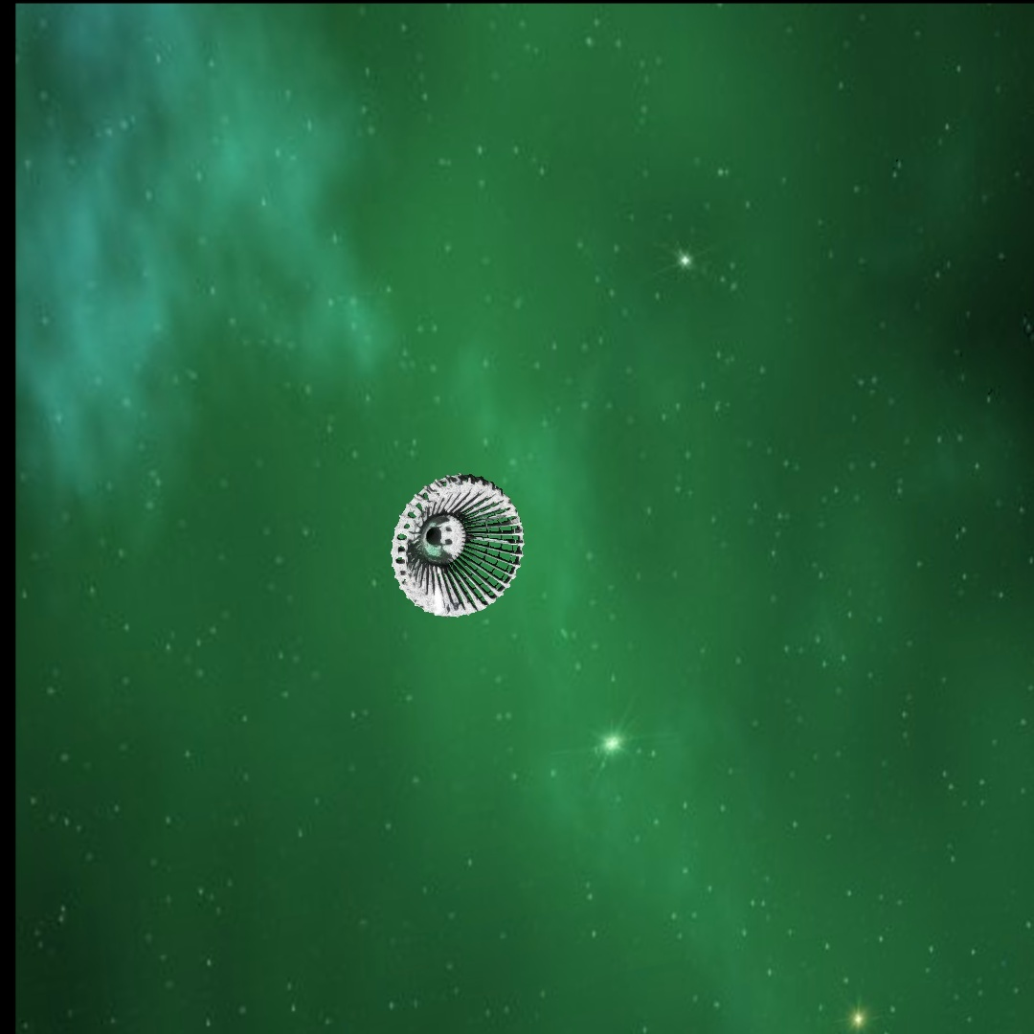
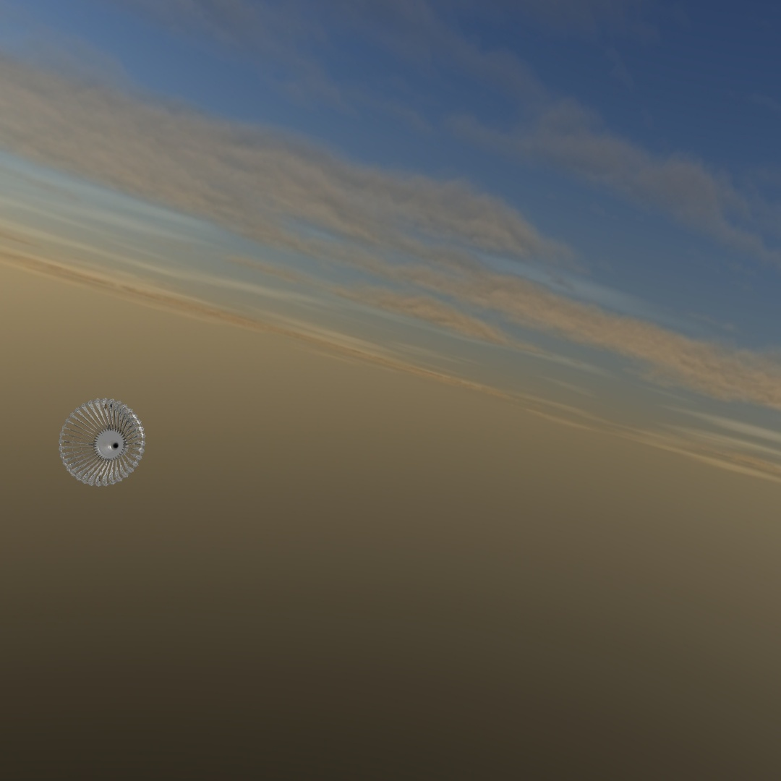
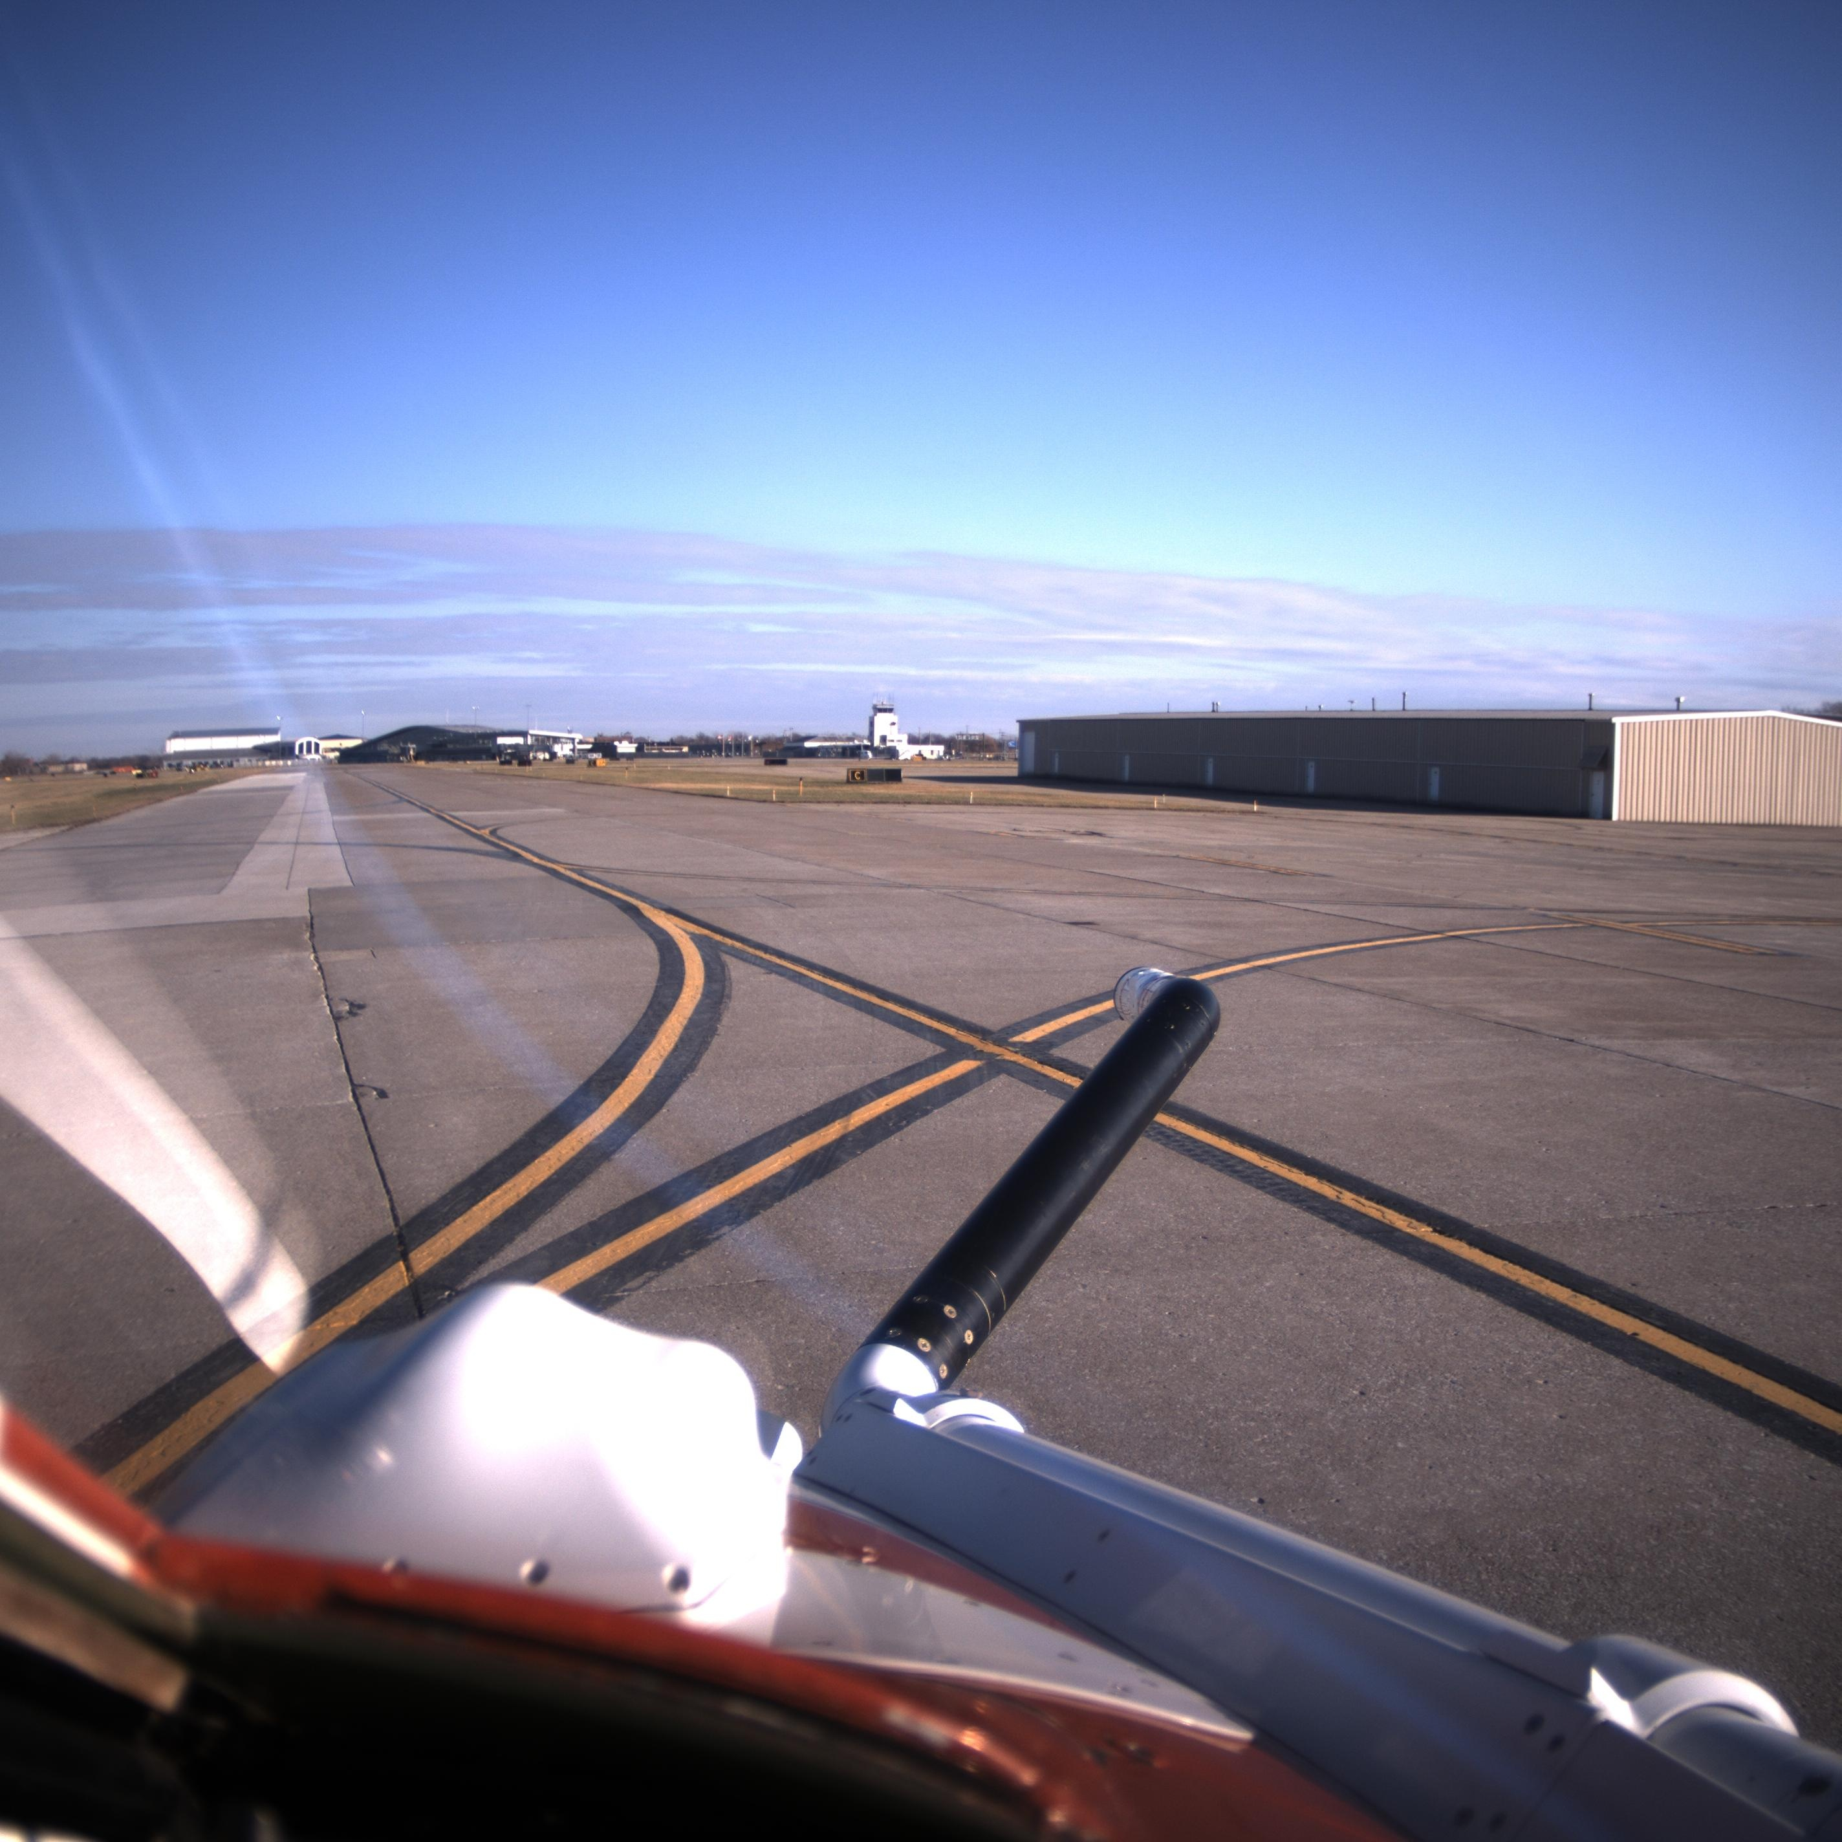
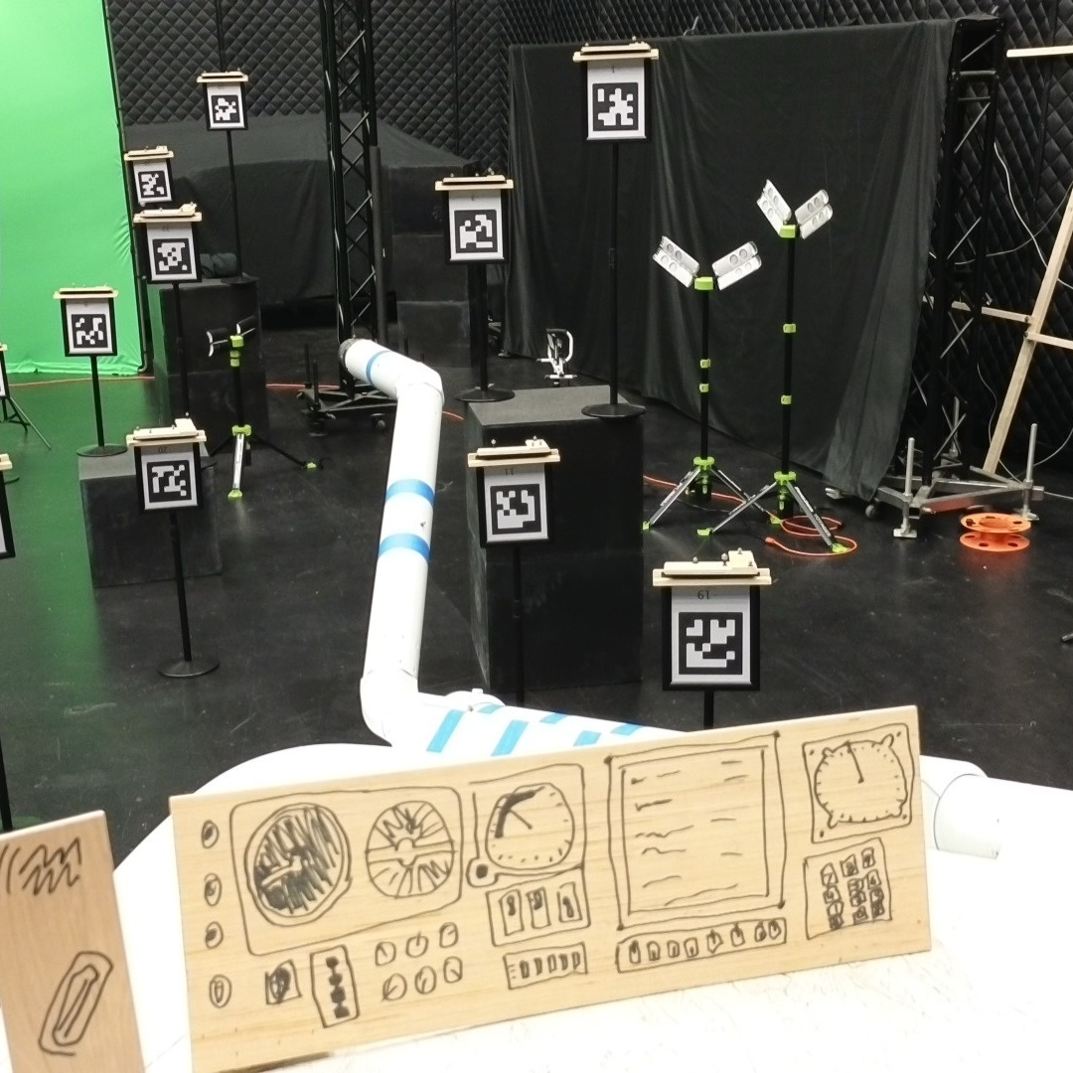
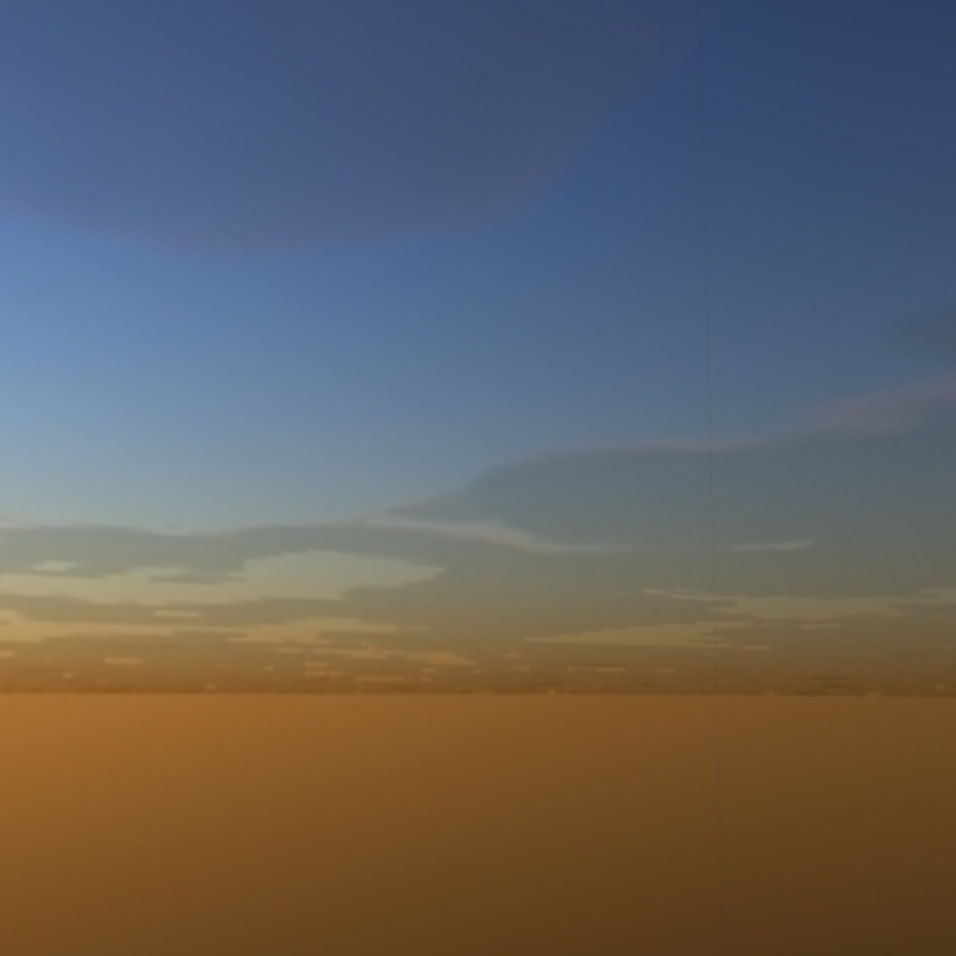
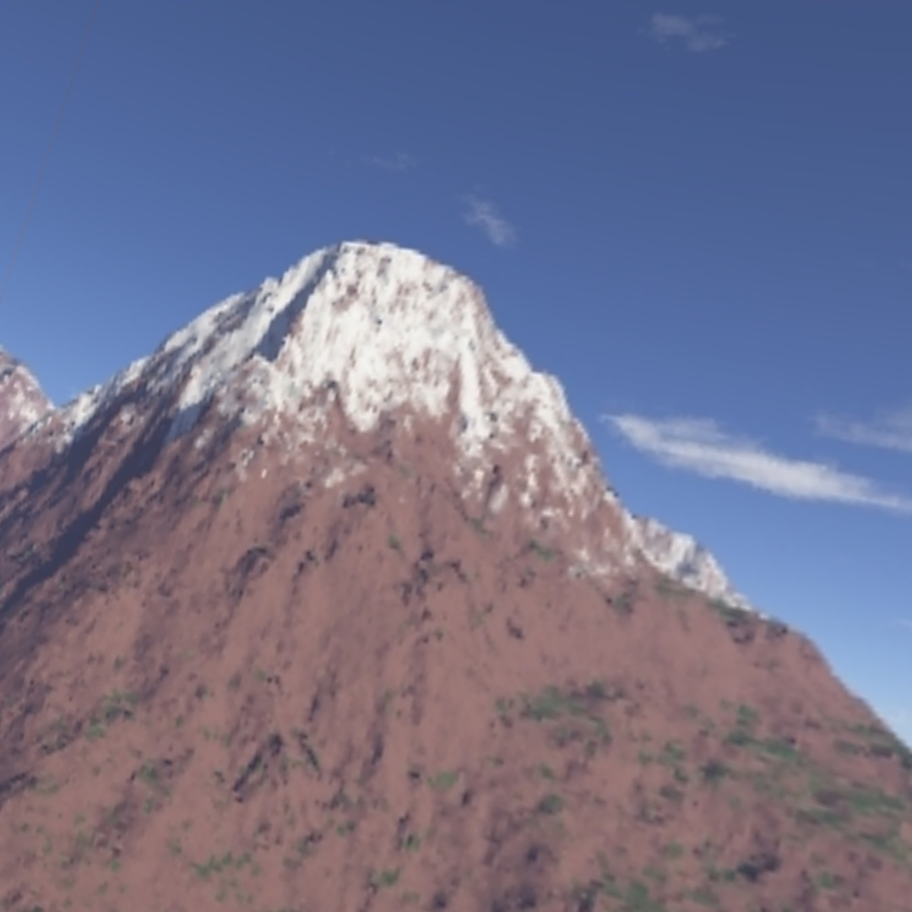
drogue
no drogue
real (tst flt)
real (lab)
hybrid (ar)
virtual

Slide 23
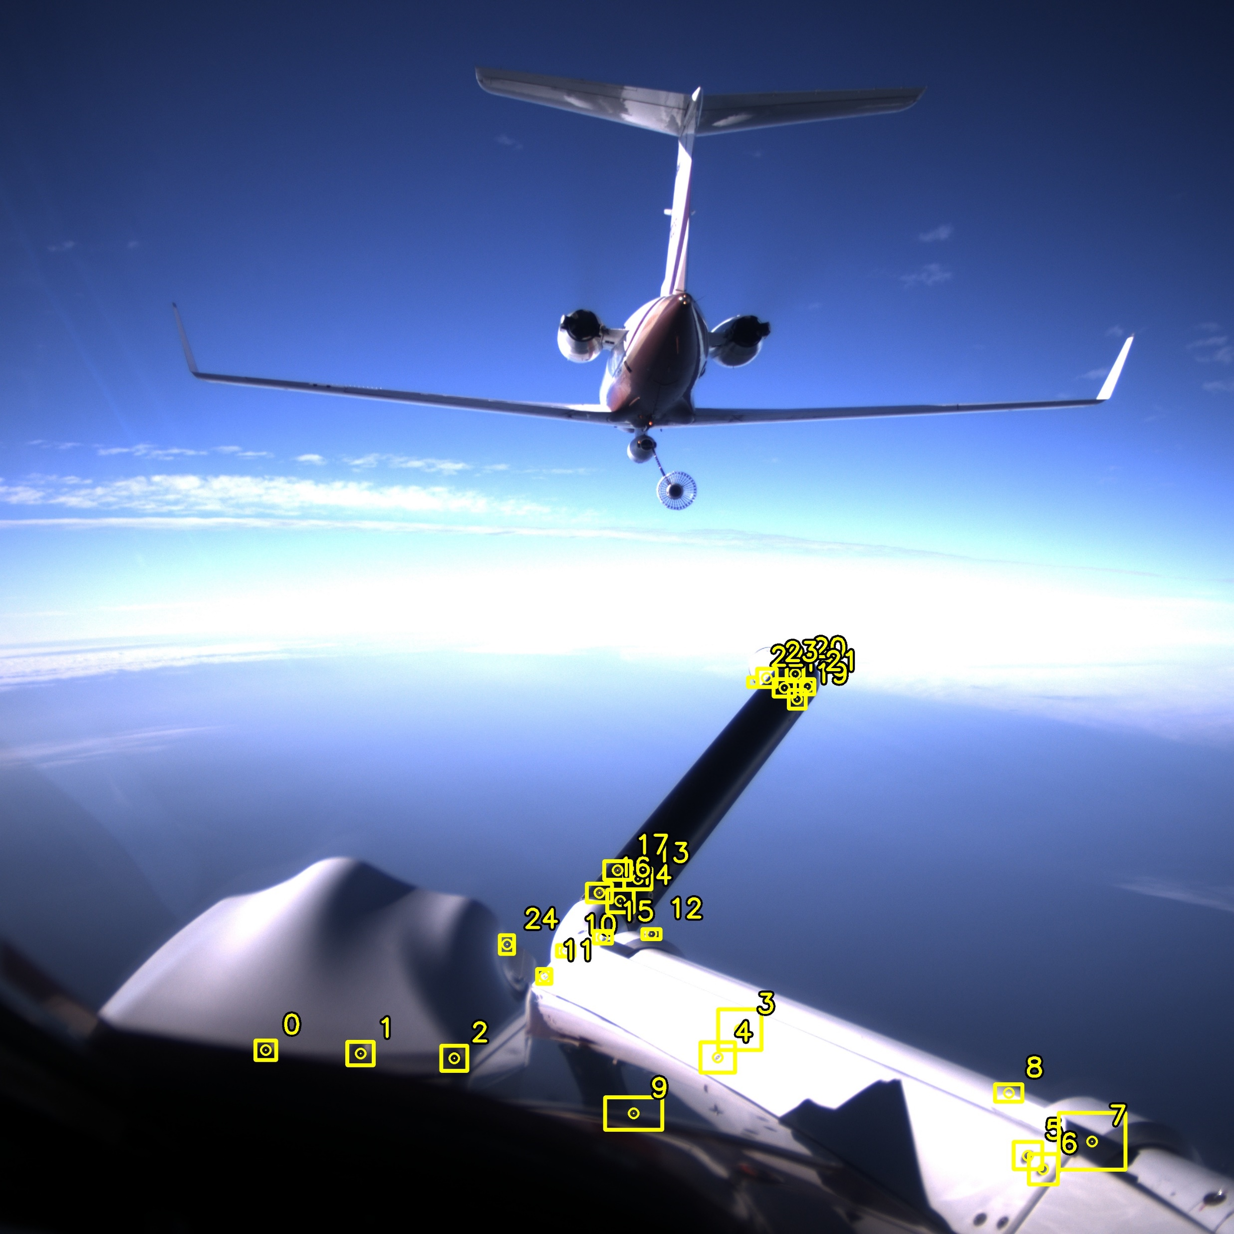
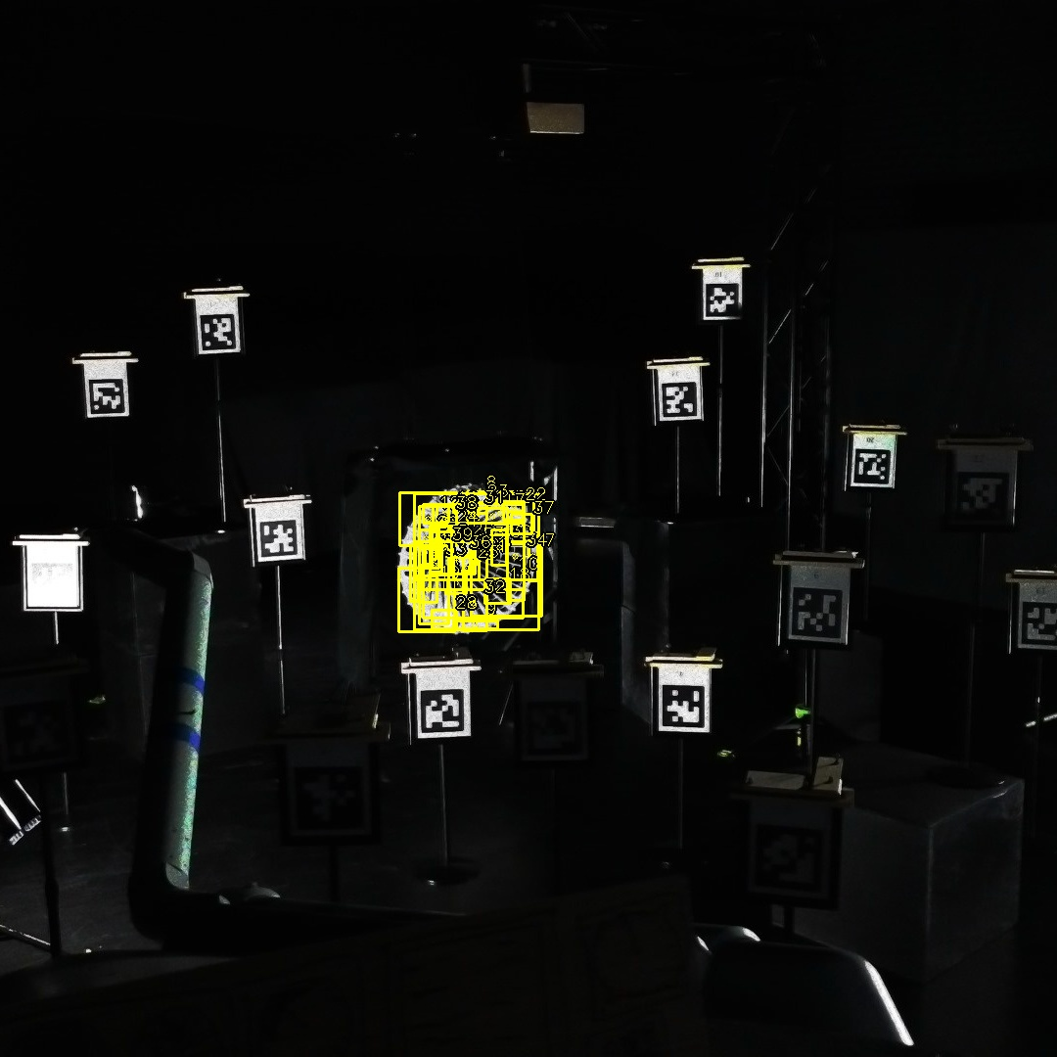
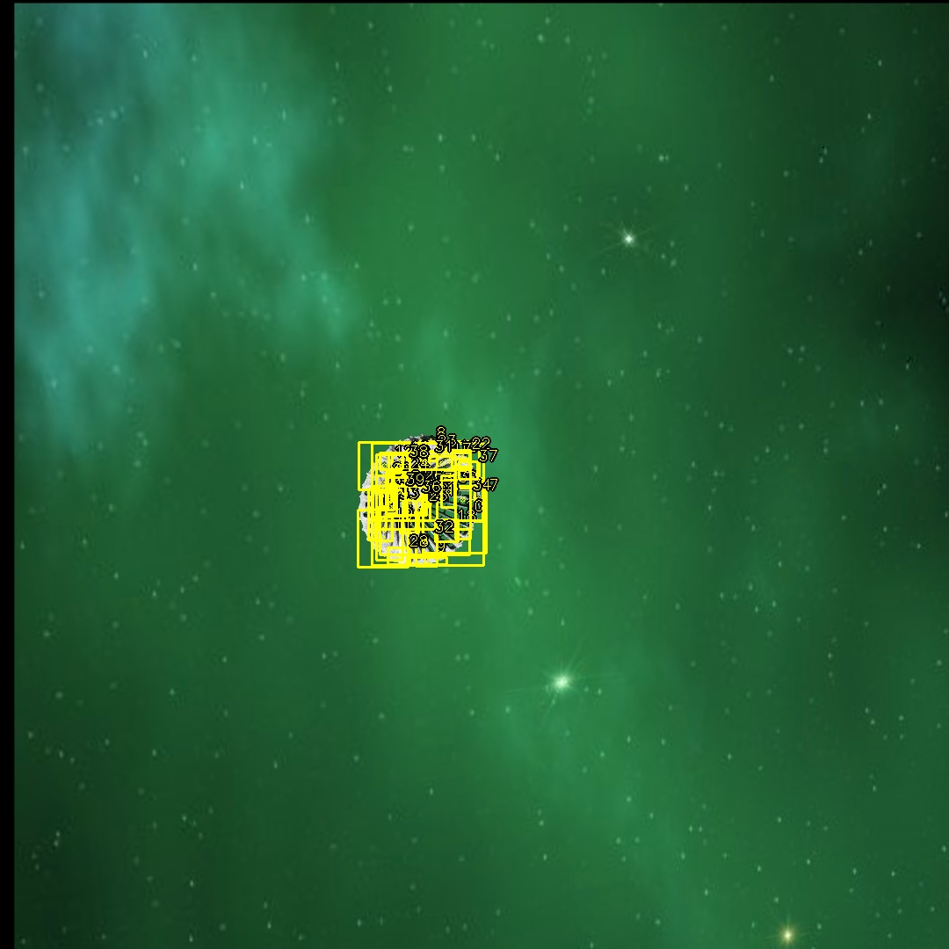
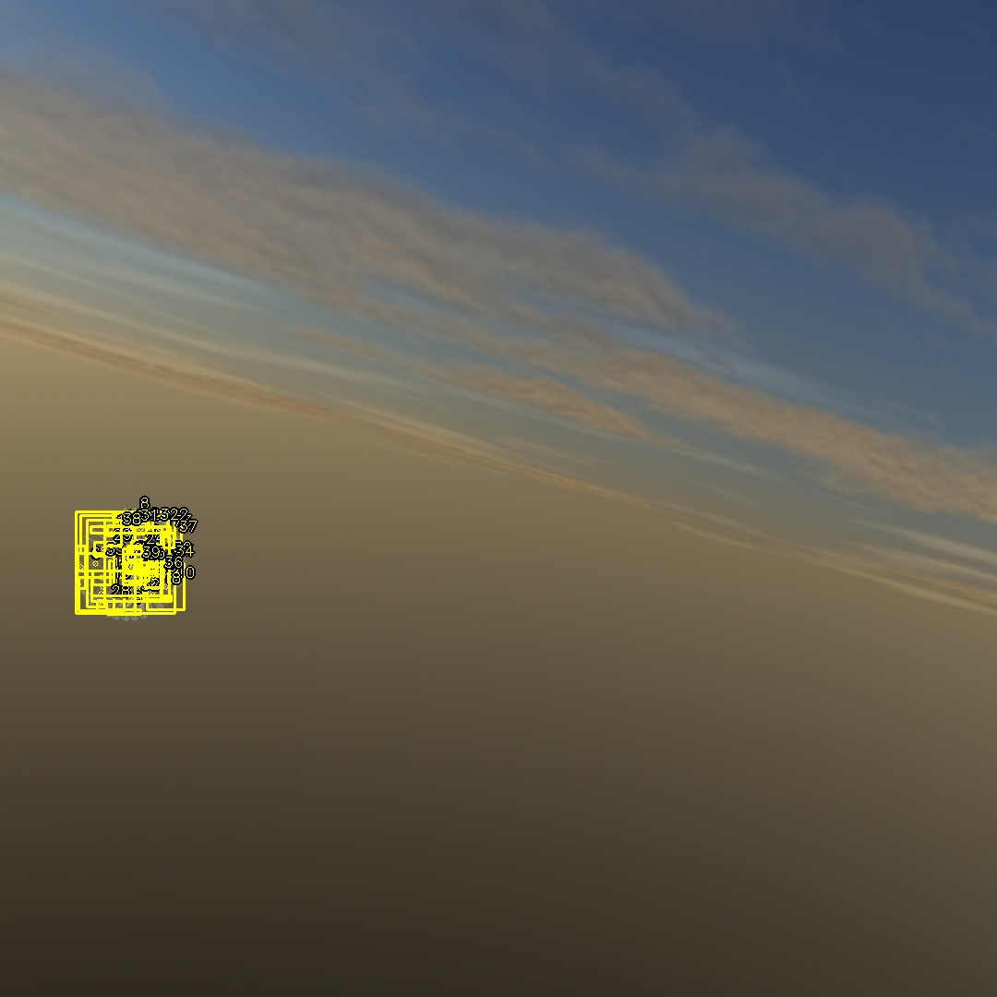
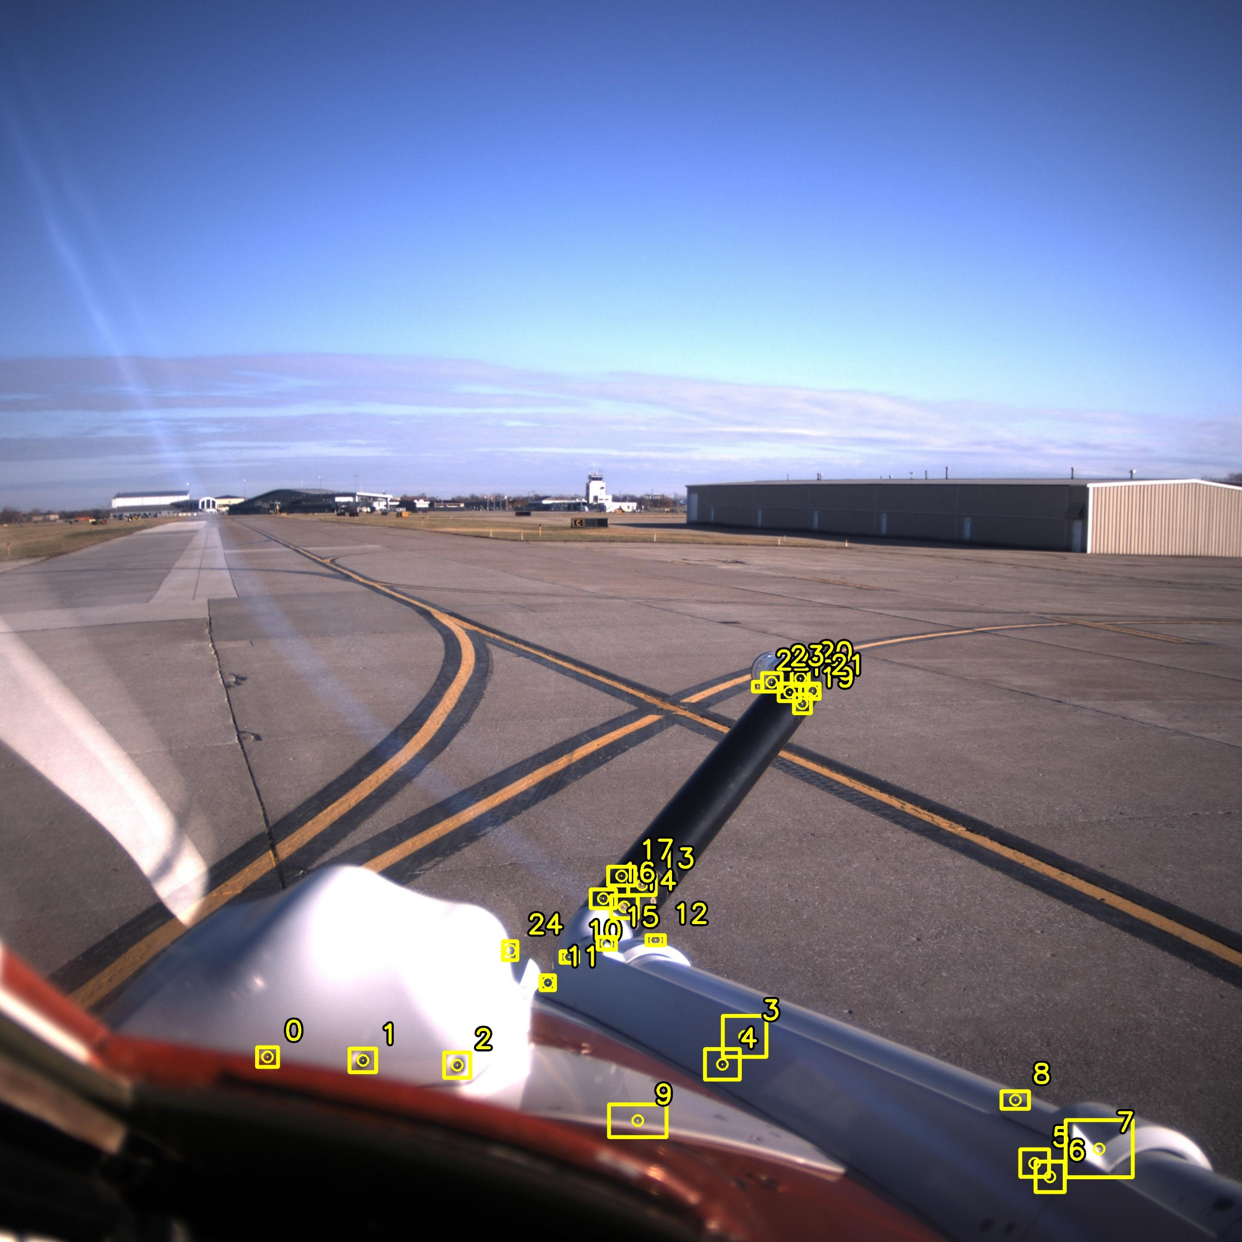
drogue
no drogue
real (tst flt)
real (lab)
hybrid (ar)
virtual

Slide 24


Dataset Composition
vr
tf
tf
lab + ar + vr
(masked)

Slide 25


Image Masking
864x864
1080x1080
2848x2848

Slide 26



2848x2848
1080x1080
864x864

Slide 27


864x864
2848x2848

Slide 28

Centering Wand (early prototype)
Taut string holds
marker balls in place
Precise center
between marker balls
Wand center
viewing hole

Slide 29
Digital Twin Alignment
Augmented Imagery

Slide 30

raw image

Slide 31

undistorted

Slide 32


raw
undistorted

Slide 33


raw
undistorted

Slide 34


raw
undistorted

Slide 35


raw
undistorted

Slide 36
Feature Performance

Slide 37


Slide 39


All Features (undistorted)
Poor Features Removed (undistorted)

Slide 40

Poor Features Removed (distorted)

